Slide 1

The United Nations (UN)
Goals, Structure, Missions, Achievements, and Global Impact

Slide 2

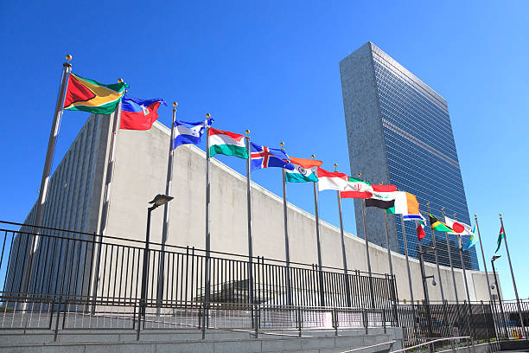
Introduction to the United Nations
Definition: An international intergovernmental organization founded to maintain international peace and security.
Established: October 24, 1945, in the immediate aftermath of World War II to succeed the League of Nations.
Headquarters: Situated in New York City, with key international offices in Geneva, Vienna, and Nairobi.
Core Purpose: Created to prevent future global conflicts, promote collaboration, and ensure human rights.
The United Nations (UN) — Educational Series
Slide 2 of 13

Slide 3
The History of the United Nations
1945
Modern
San Francisco: Delegates from 50 nations gather to write and sign the official UN Charter.
Global Growth: Expansion to 193 sovereign states representing almost the entire world.
1941
1945
Atlantic Charter: Drafted by the US & UK to establish principles for global post-war security.
Ratification: On October 24, the UN officially begins operations with 51 founding states.
The United Nations (UN) — Educational Series
Slide 3 of 13

Slide 4






Core Goals and Objectives
Peace & Security
Human Rights
Global Development
Preventing regional and global conflicts, resolving disputes peacefully, and deploying active peacekeeping operations.
Protecting fundamental freedoms globally as outlined in the landmark Universal Declaration of Human Rights (UDHR).
Fostering social progress, encouraging economic development, and protecting the biosphere from climate change.
The United Nations (UN) — Educational Series
Slide 4 of 13

Slide 5
Principal Organs of the UN
Principal Organ | Core Function / Role | Key Composition & Authority
General Assembly | Main deliberative, policymaking, and representative body. | All 193 Member States have equal voting power (1 vote each).
Security Council | Maintains international peace and security. | 15 members; 5 permanent with veto power (P5).
ECOSOC | Coordinates economic, social, and environmental works. | 54 members elected by the General Assembly.
Int'l Court of Justice | Principal judicial organ (headquartered in The Hague). | 15 judges resolving legal disputes between states.
Secretariat | Executes day-to-day administrative work. | Led by the Secretary-General and thousands of staff.
The United Nations (UN) — Educational Series
Slide 5 of 13

Slide 6


Specialized Agencies & Programs
UNICEF & WHO
UNESCO & UNDP
FAO & WFP
UNICEF advocates for children's health, education, and safety. WHO directs international public health programs and emergency response.
UNESCO protects cultural heritage and promotes education. UNDP drives economic growth and works to eradicate systemic poverty.
FAO leads global agricultural improvements. WFP delivers immediate, life-saving food aid to conflict zones and disaster areas.
The United Nations (UN) — Educational Series
Slide 6 of 13

Slide 7
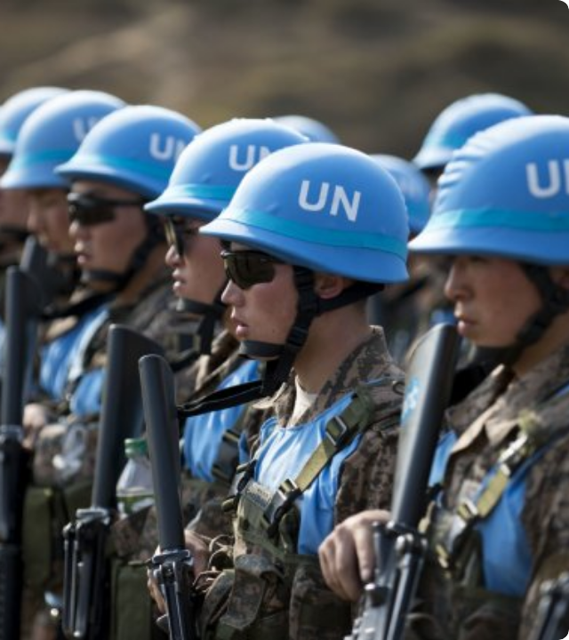
Global Missions & Activities
Peacekeeping: Deploying active multinational forces to buffer zones to manage post-conflict stability.
Humanitarian Aid: Delivering emergency food, shelter, and medical support to refugees.
Climate Action: Facilitating international treaties like the Paris Agreement to curb greenhouse gases.
The United Nations (UN) — Educational Series

Slide 8


The Sustainable Development Goals
The 17 Goals for 2030
Adopted in 2015, the SDGs represent a universal call to action to end poverty, protect the planet, and ensure prosperity for all by 2030.
People: Eradicate hunger and poverty; ensure health & education equity.
Planet: Protect oceans, terrestrial systems, and combat climate change.
Prosperity: Decent work, clean energy, and sustainable infrastructure.
The United Nations (UN) — Educational Series
Slide 8 of 13

Slide 9
Key Milestones & Achievements
Conflict Prevention: Successfully resolved regional conflicts and prevented potential third-world escalations since 1945.
172
Disease Eradication: Led global vaccination campaigns, successfully eradicating Smallpox in 1980.
PEACE SETTLEMENTS
Humanitarian Reach: Actively feeds and assists over 100 million people across 80+ nations annually.
The United Nations (UN) — Educational Series
Slide 9 of 13

Slide 10


Inherent Challenges & Criticisms
Political Hurdles
Operational Issues
The veto power of the five permanent Security Council members often blocks critical humanitarian intervention, causing geopolitical gridlock during severe crises.
Ongoing funding limitations, bureaucratic overhead delays, and national sovereignty concerns restrict direct, swift enforcement of international laws.
The United Nations (UN) — Educational Series
Slide 10 of 13

Slide 11



Interesting Facts About the UN
193 Members
6 Official Languages
International Soil
Represents almost 100% of the world's sovereign population. Only the Vatican City and Palestine hold permanent observer status.
Arabic, Chinese, English, French, Russian, and Spanish are the official working languages of all central UN forums.
The headquarters land in New York City is international territory, protected by its own security and official laws.
The United Nations (UN) — Educational Series
Slide 11 of 13

Slide 12
THANKS FOR LISTENING!
"
"The UN was not created to take mankind to heaven, but to save humanity from hell."
"
— Dag Hammarskjöld, 2nd UN Secretary-General
A vital global bridge fostering multilateral diplomacy, humanitarian assistance, and common planetary goals.
The United Nations (UN) — Educational Series
Slide 12 of 13

