Slide 1
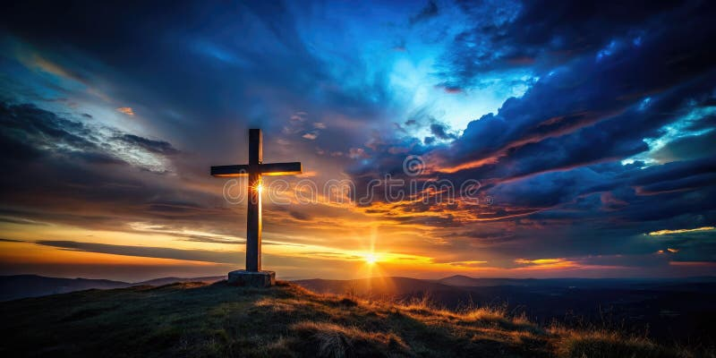
CHRISTIANITY
ONE FAITH, MANY POSSIBILITIES

Slide 2
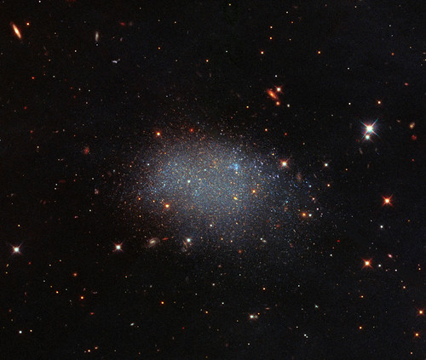
THE VOID: BEFORE THE BEGINNING
Before the beginning, Christians believe there was no universe at all—no matter, space, or even time—only God, who is eternal and not bound by creation. This idea means that “before” creation is not a normal moment in time, but a state where only God existed. According to the Book of Genesis, God created the world out of nothing, showing His absolute power. The beginning of the world, therefore, marks the start of time and reality as humans understand it.
This Photo by Unknown Author is licensed under CC BY

Slide 3
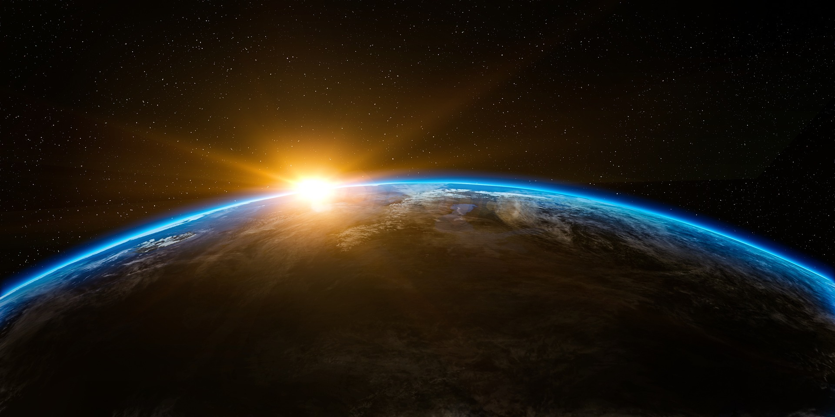


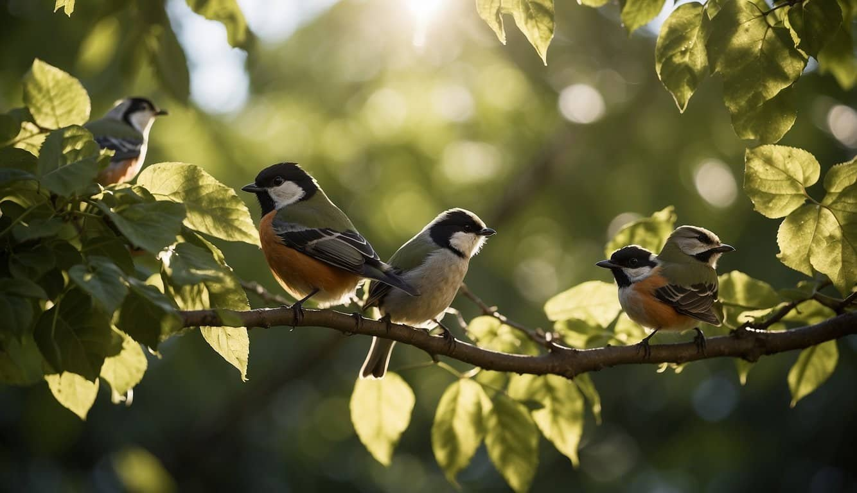

CREATION UNFOLDS
The Christian creation story, found in the Book of Genesis The Christian creation story, found in the Book of Genesis, explains how the world began with purpose. In the beginning, God created the universe in six days: light and darkness, the sky, land and plants, the sun, moon and stars, animals, and finally humans—Adam and Eve—who were made in His image. They were given free will and lived in the Garden of Eden, but disobeyed God by eating from the forbidden tree. This event, known as the Fall, brought sin and suffering into the world. On the seventh day, God rested, establishing a pattern of rest. The story is not just about creation, but about choice, responsibility, and the consequences of human actions. Everything was perfect… until humans made their first bad decision
This Photo by Unknown Author is licensed under CC BY

Slide 4
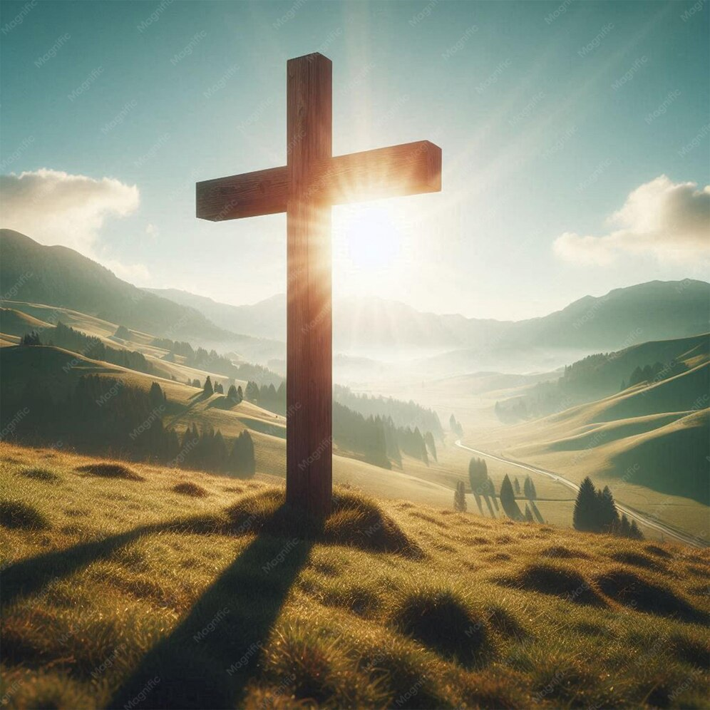
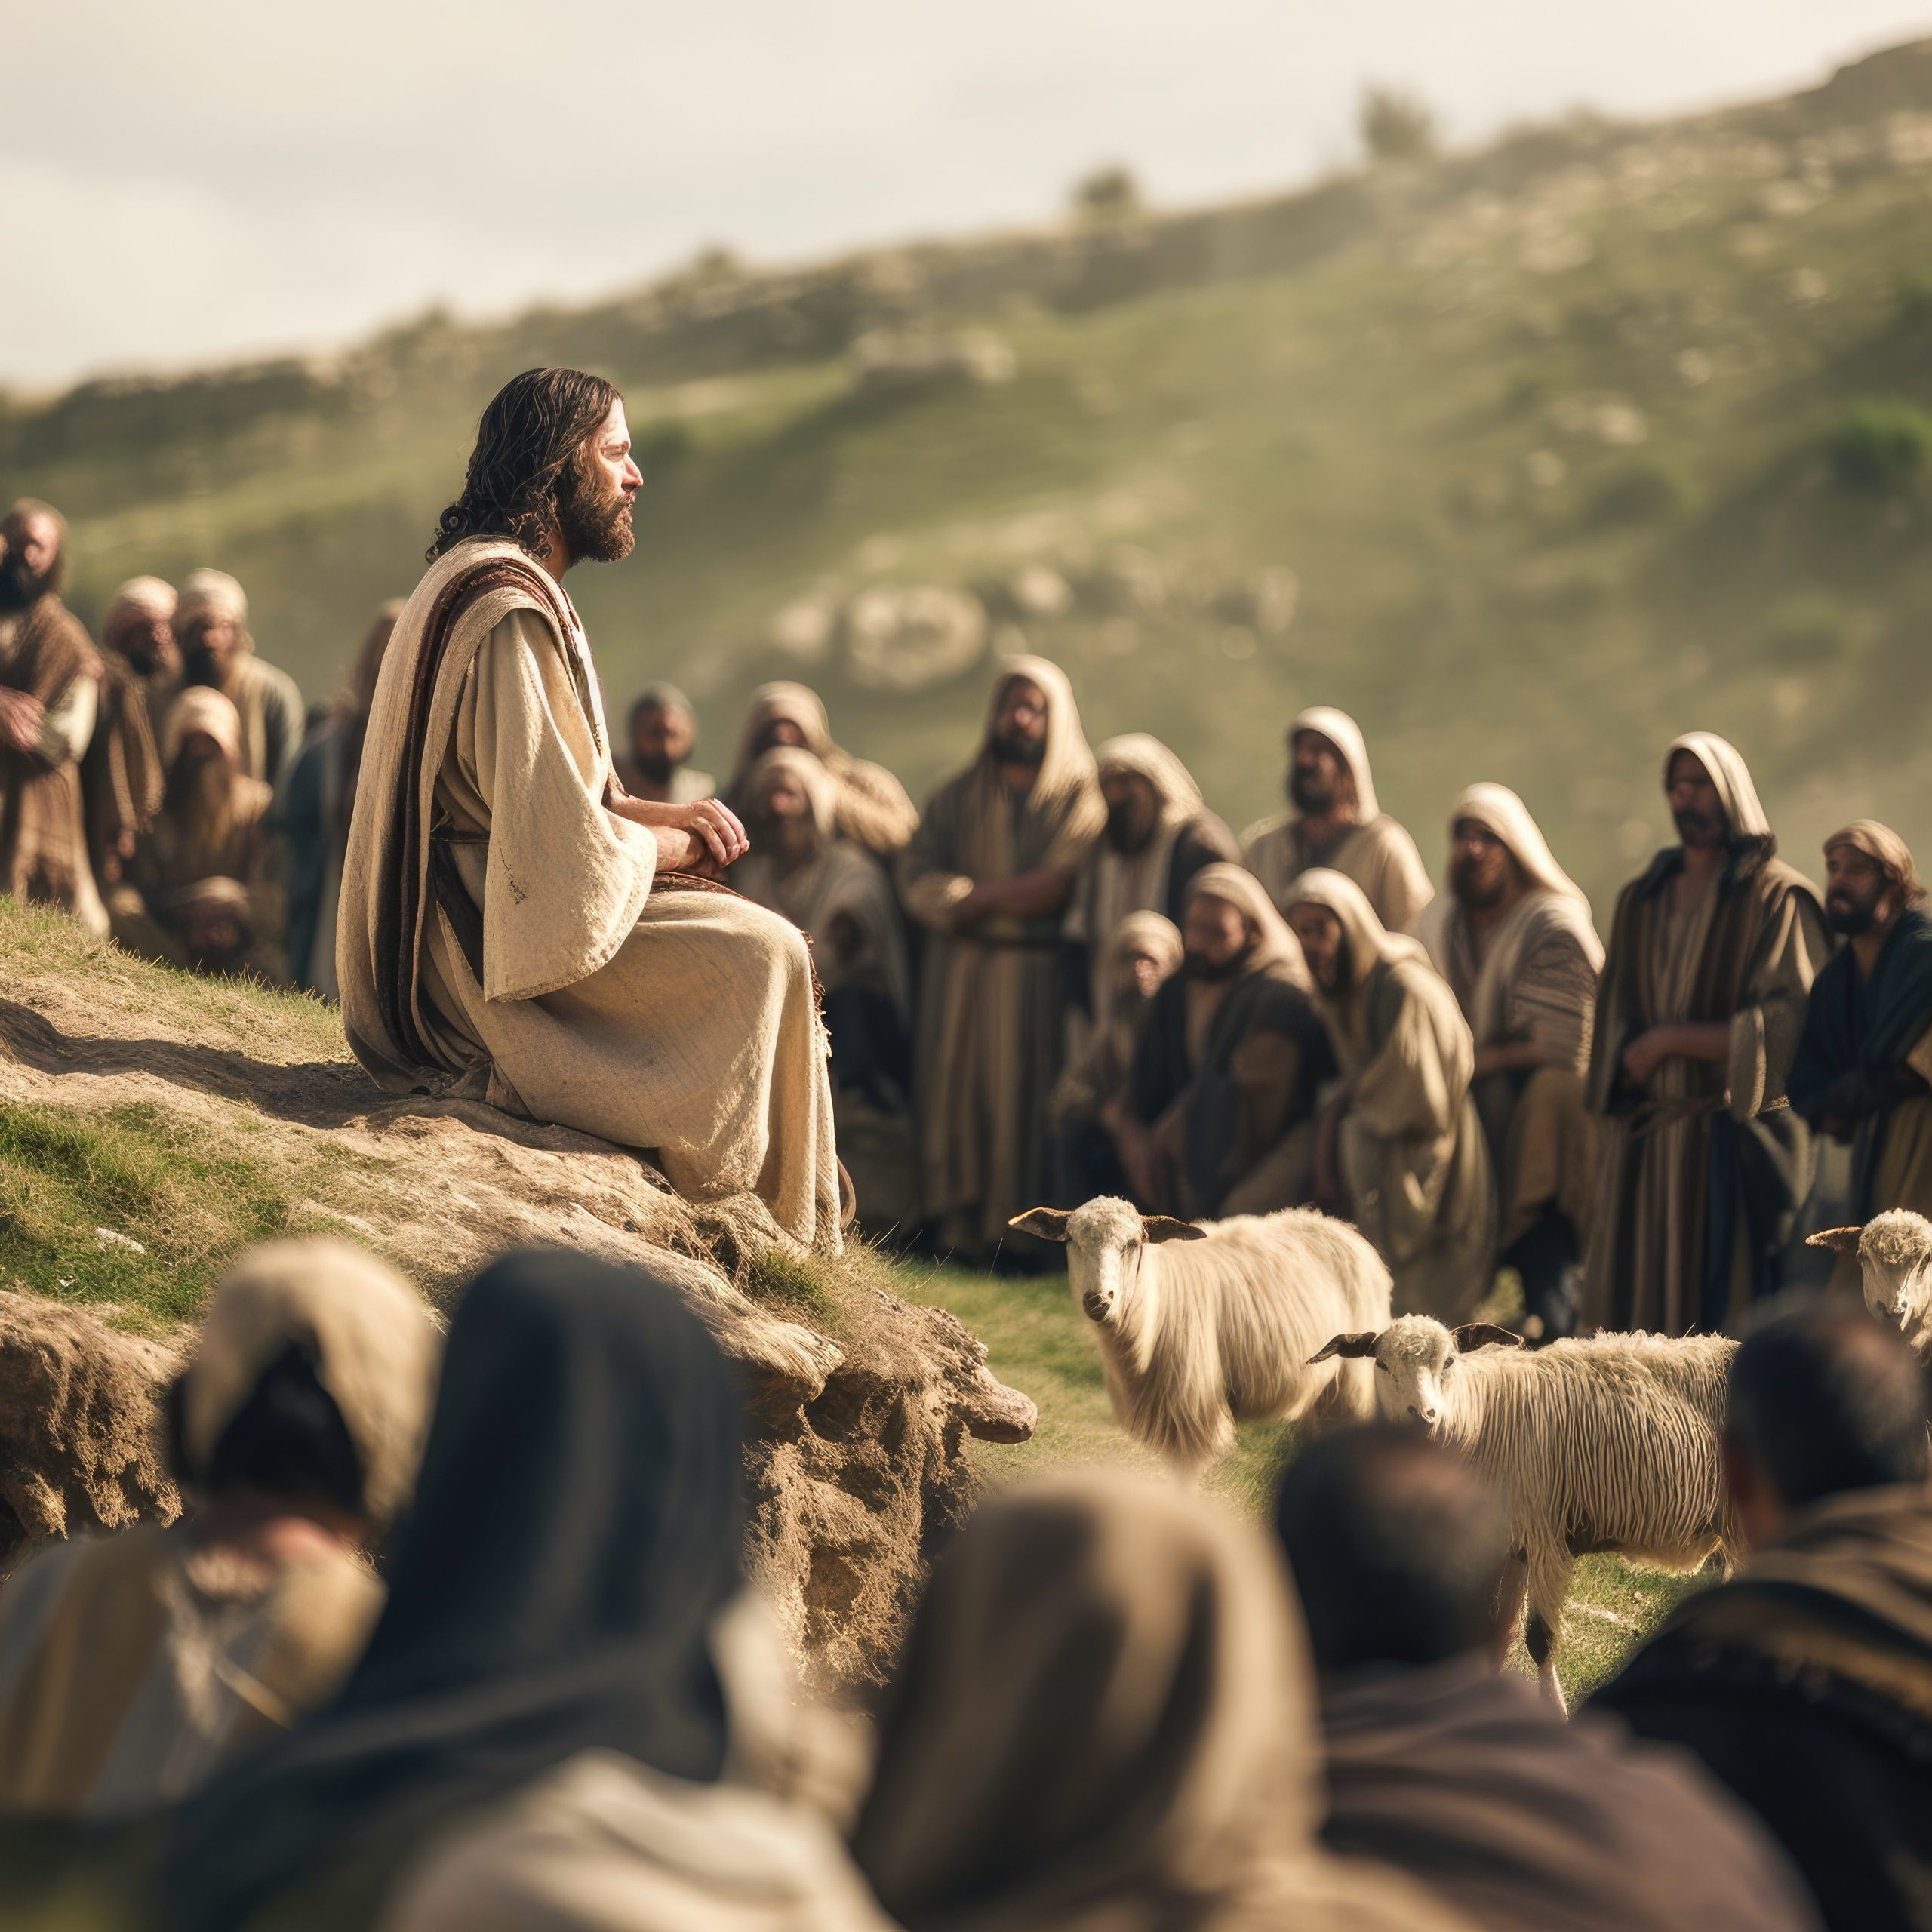
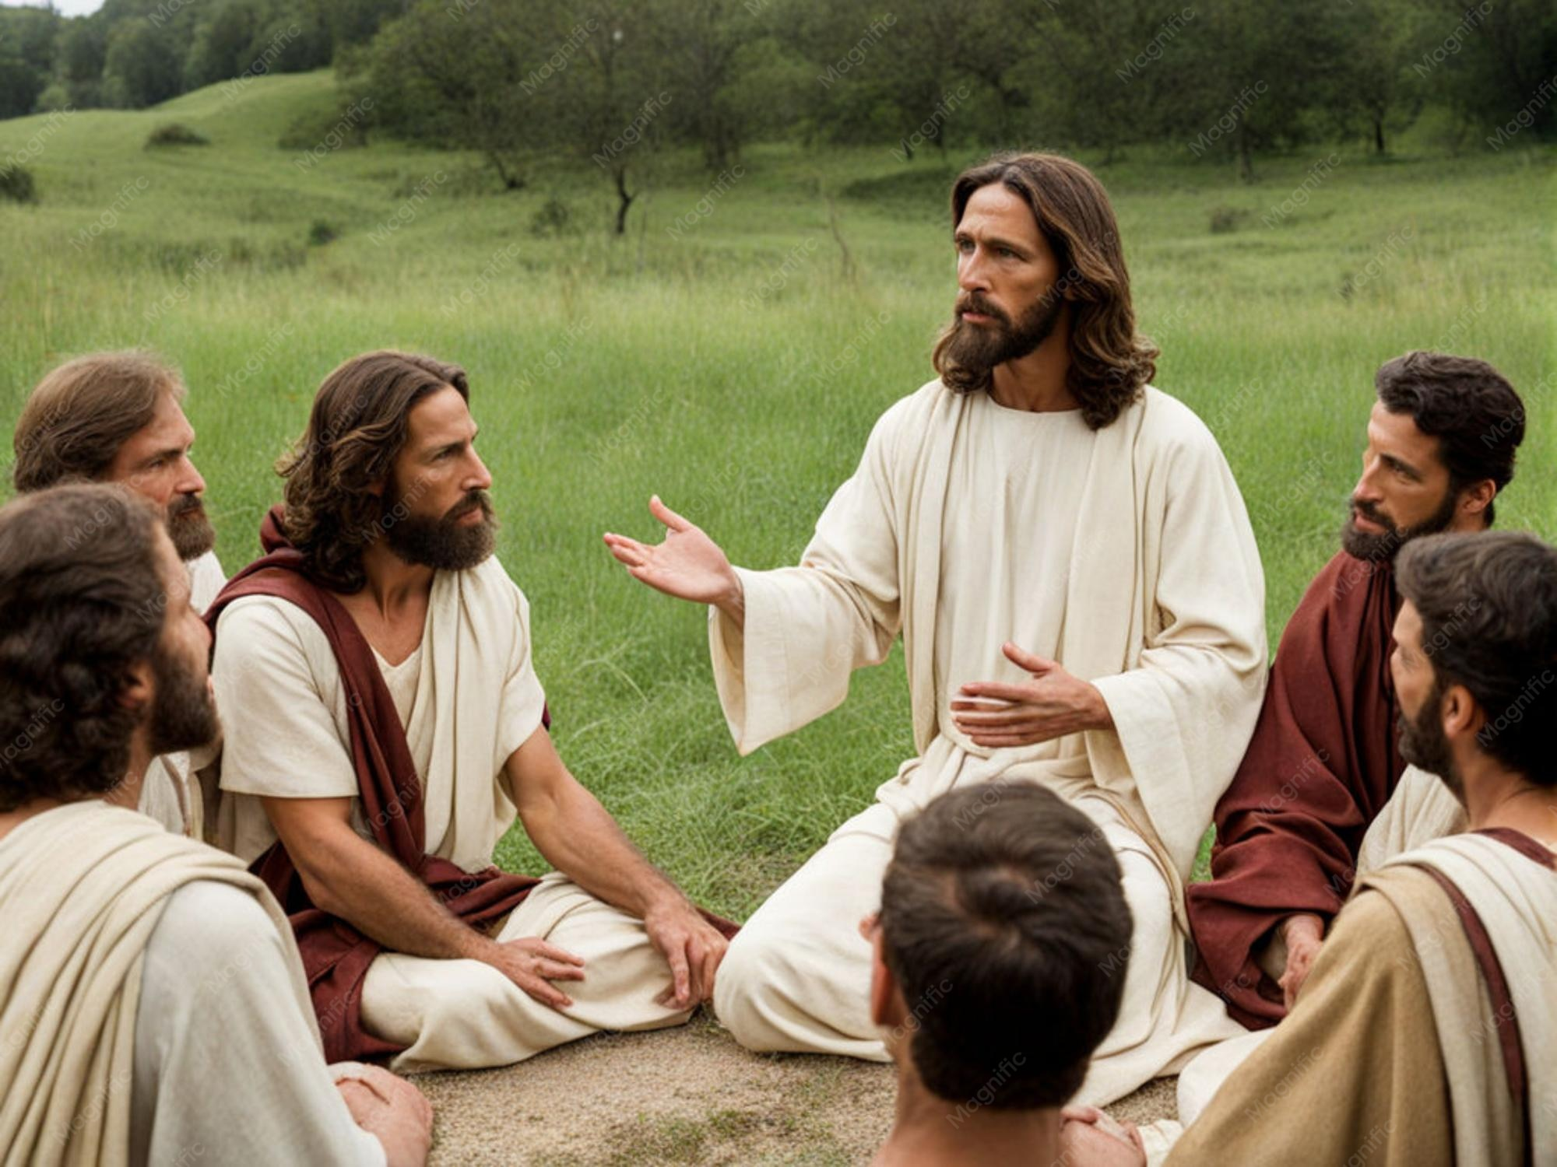
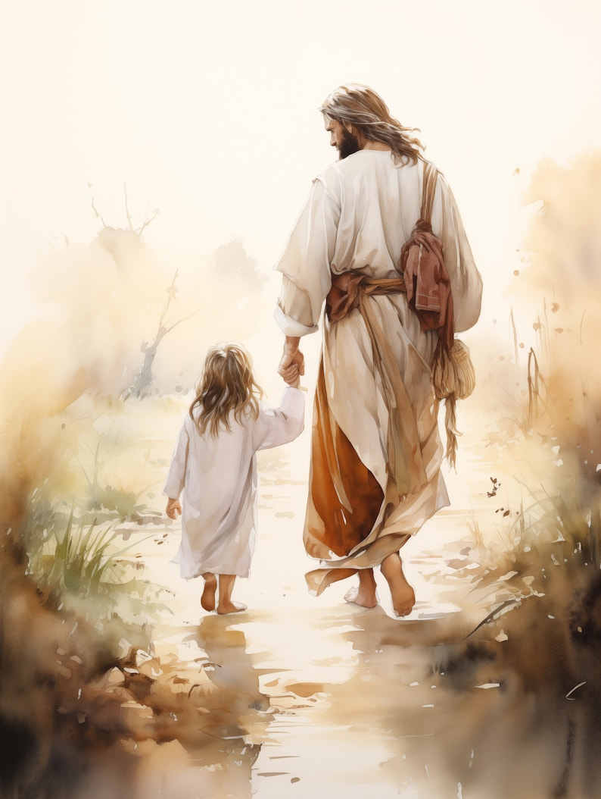
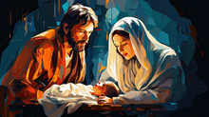
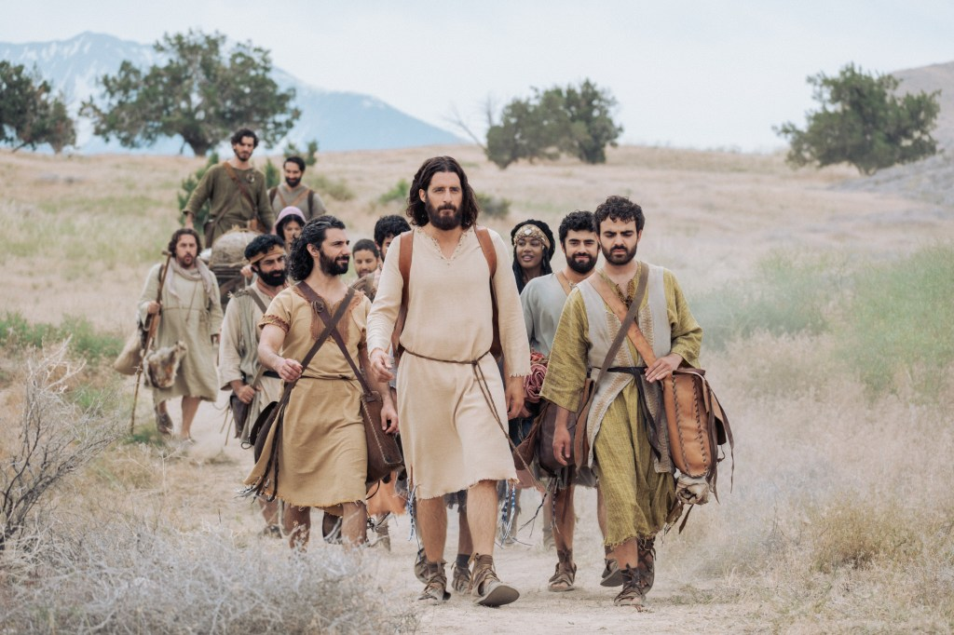
THE ARRIVAL OF A FIGURE
The birth of Jesus Christ, celebrated at Christmas, marks the moment Christians believe God entered the world in human form. Born in humble circumstances in Bethlehem to Mary and Joseph, His arrival fulfilled longstanding prophecies of a Savior. For Christians, His coming brought hope, love, and the promise of salvation, transforming lives by teaching compassion, forgiveness, and faith. His birth is seen not just as a historical event, but as the beginning of a new relationship between God and humanity, shaping Christian beliefs and practices to this day.

Slide 5
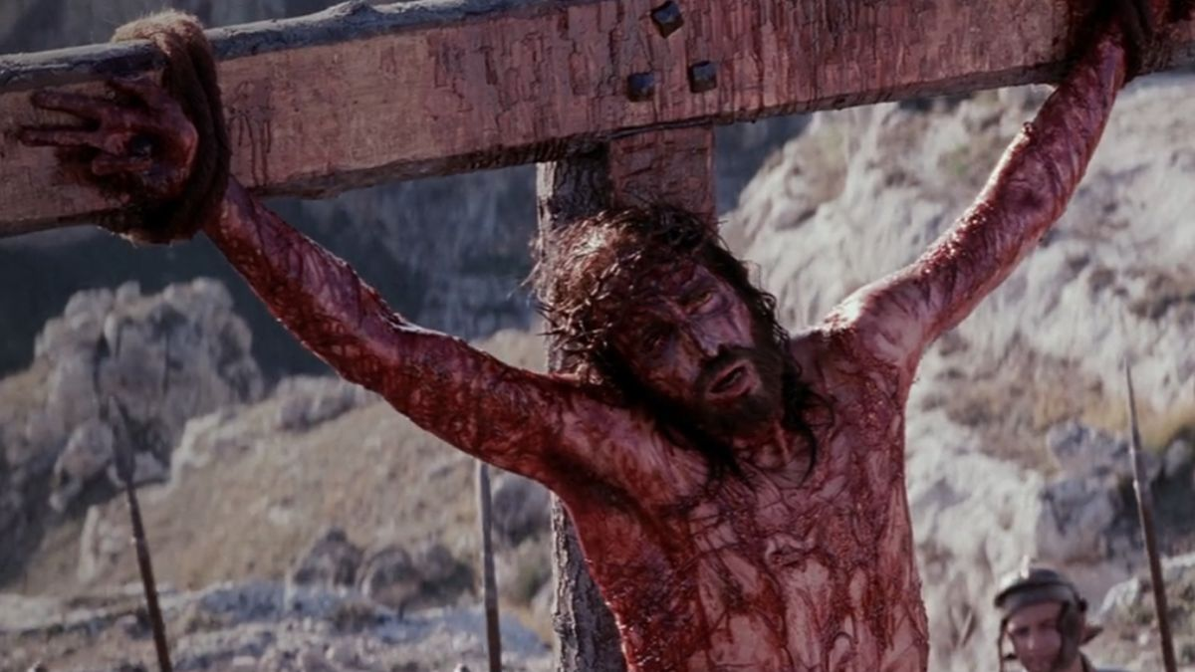
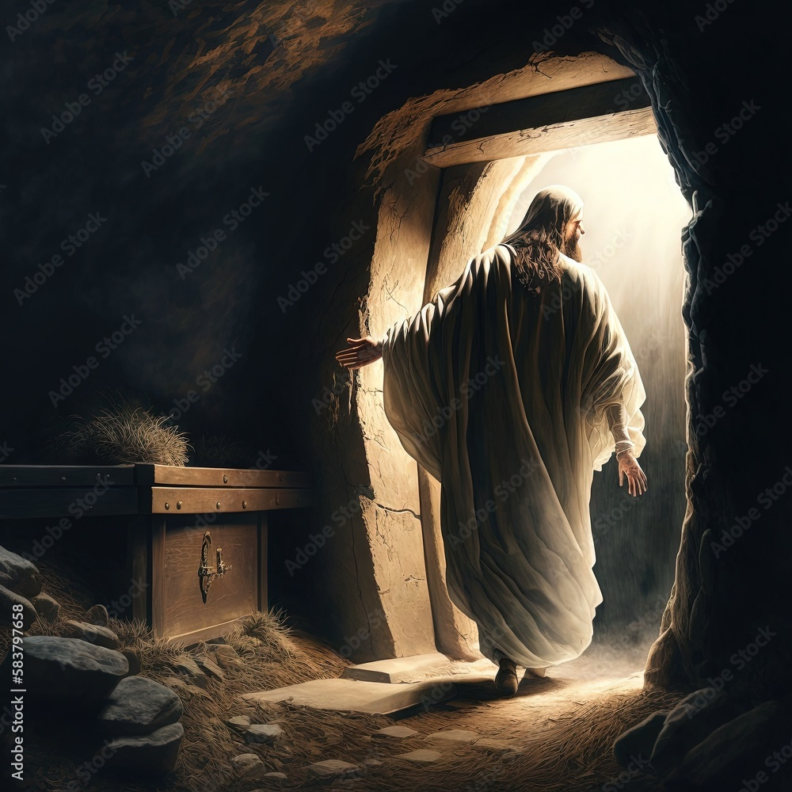
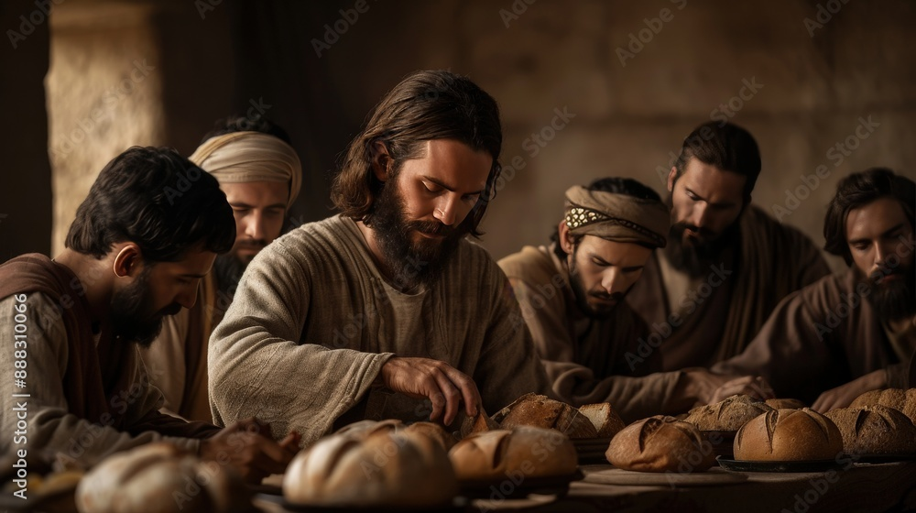
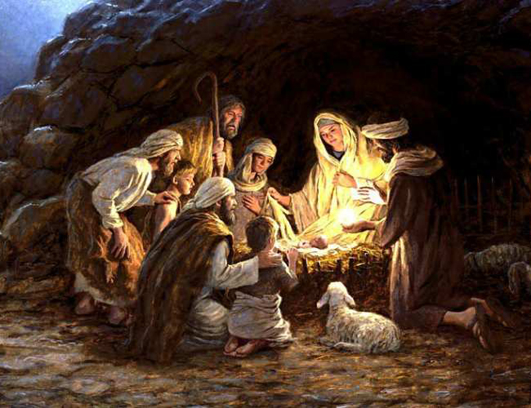
FESTIVALS
Christian festivals such as Christmas and Easter are widely celebrated around the world, blending deep religious meaning with cultural traditions. Christmas marks the birth of Jesus Christ and symbolizes hope and joy, while Easter commemorates his resurrection, representing sacrifice and new beginnings. Beyond these well-known celebrations, seasons like Advent prepare believers for Christmas through reflection and anticipation, while Lent is a time of sacrifice leading up to Easter. Pentecost marks the coming of the Holy Spirit and the beginning of the Church’s mission. Although many people today celebrate these occasions through food, gifts, and fun activities, their original meanings are deeply rooted in faith and spiritual reflection. These festivals continue to bring people together, reminding them of important values even in a modern, commercialized world.

Slide 6
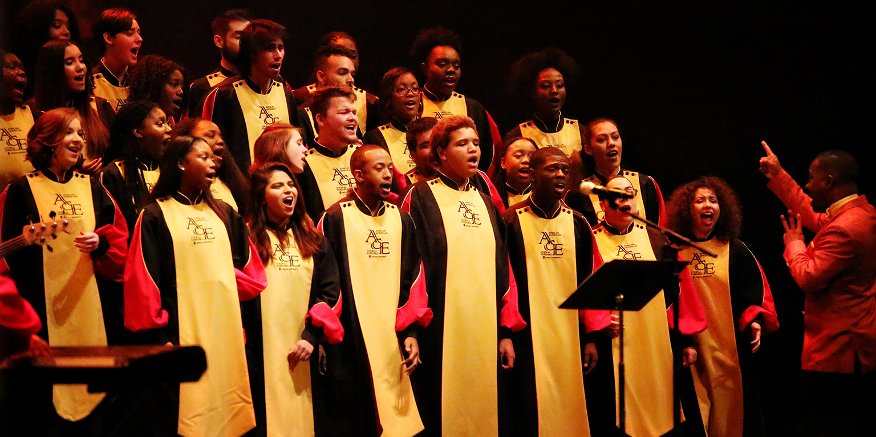
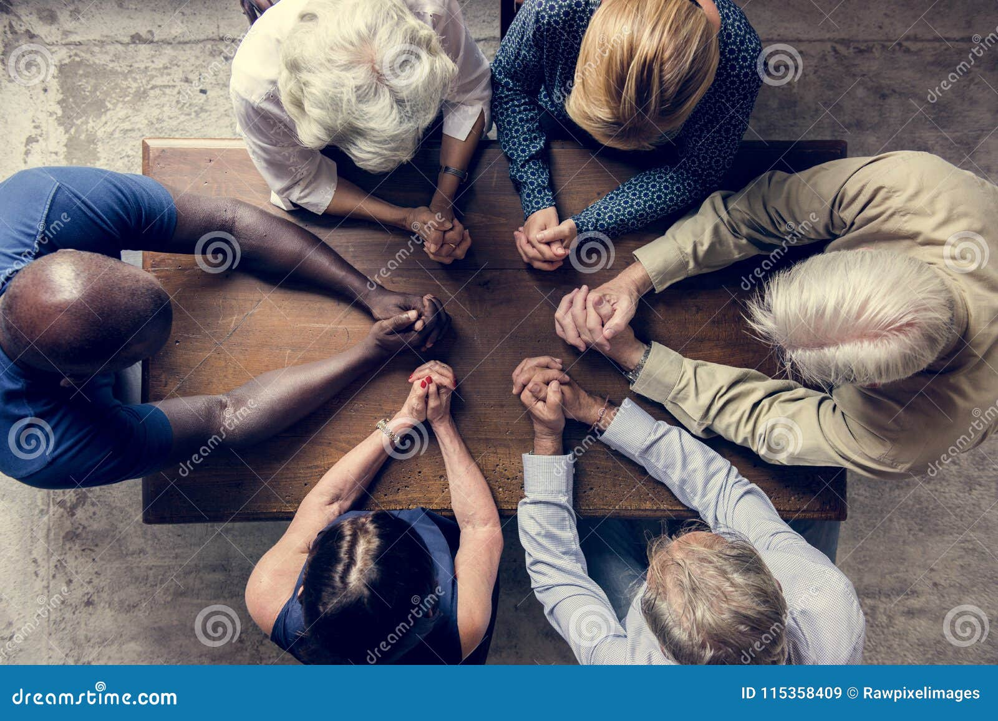
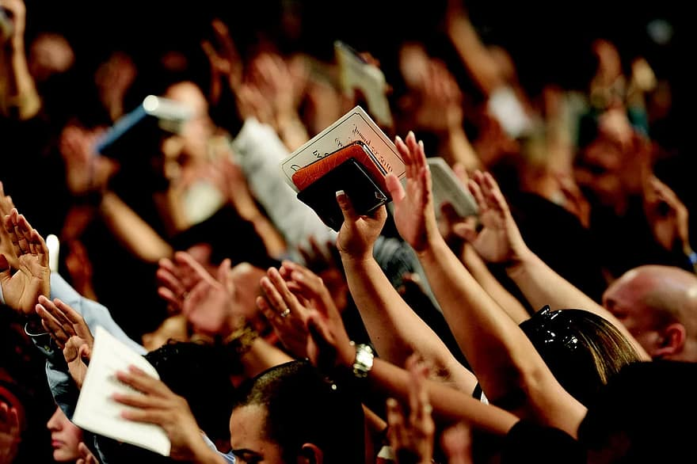
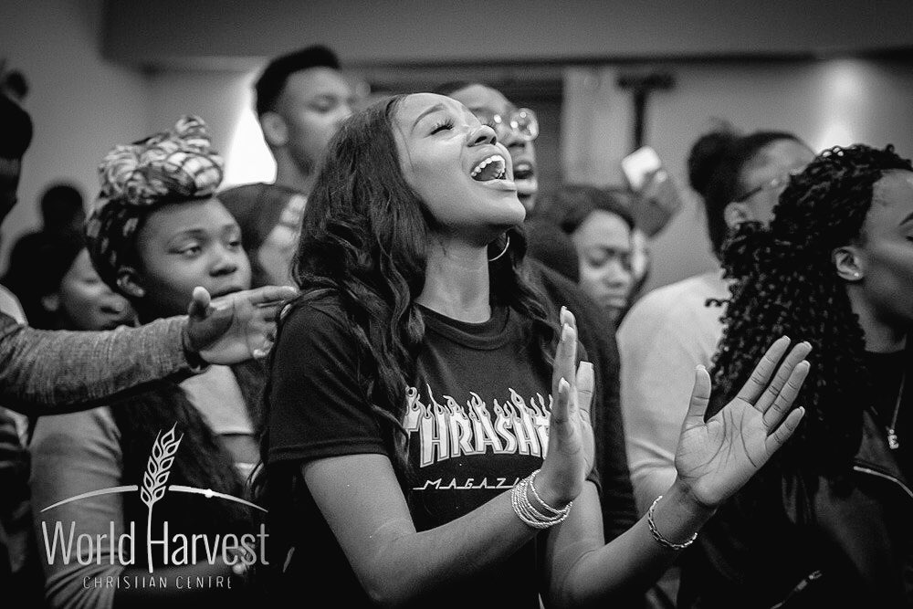
PRACTICES
Christian practices like praying, singing, reading the Bible, and going to church are at the heart of the faith. Praying brings believers closer to God, while singing and worship fill hearts with joy and unite the community. Reading the Bible guides daily life, and sacraments like baptism and communion deepen faith in powerful ways. These practices don’t just follow tradition—they inspire, strengthen, and keep the spirit of Christianity alive, shaping how believers live, love, and connect with one another.

Slide 7
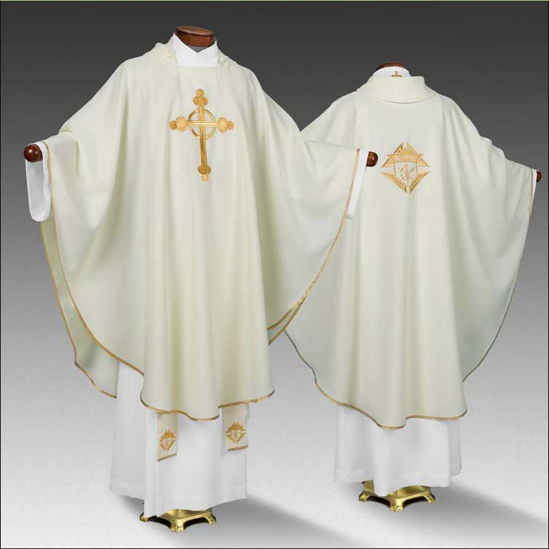
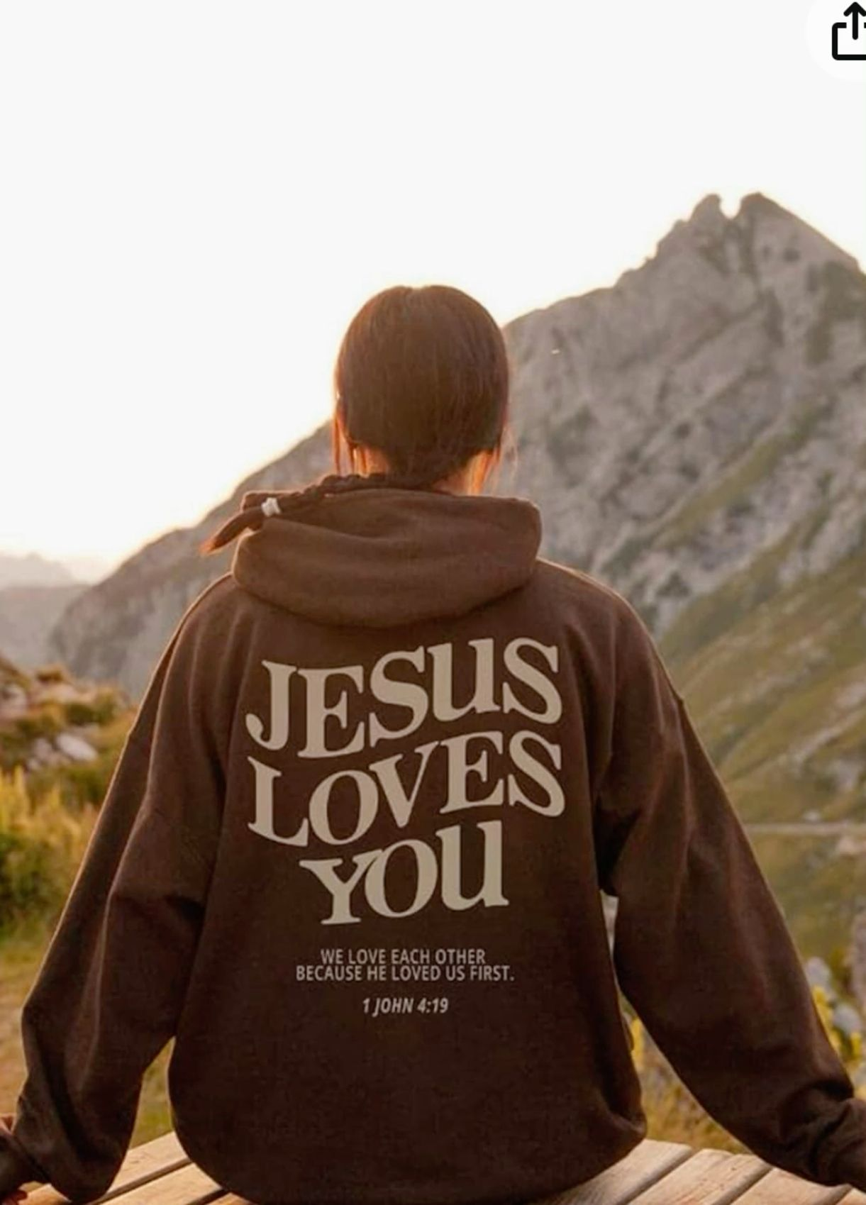
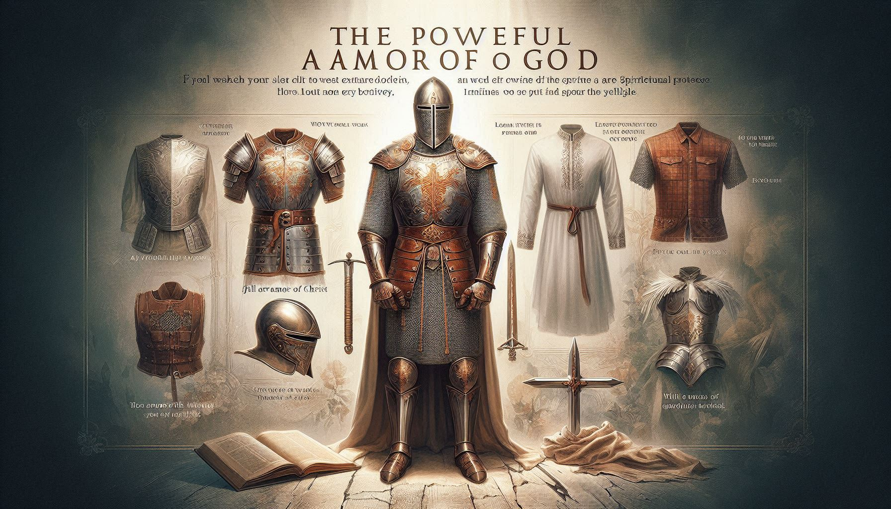
COSTUMES
In Christianity, what people wear isn’t just clothes—it’s like wearing your faith on your sleeve! Priests rock robes and stoles that show their special role, while baptism gowns shout “new beginnings!” during one of life’s biggest moments. During festivals and ceremonies, colorful and sacred outfits make everything feel exciting and holy. These costumes bring tradition to life, spark joy, and help everyone feel connected to God and each other.

Slide 8
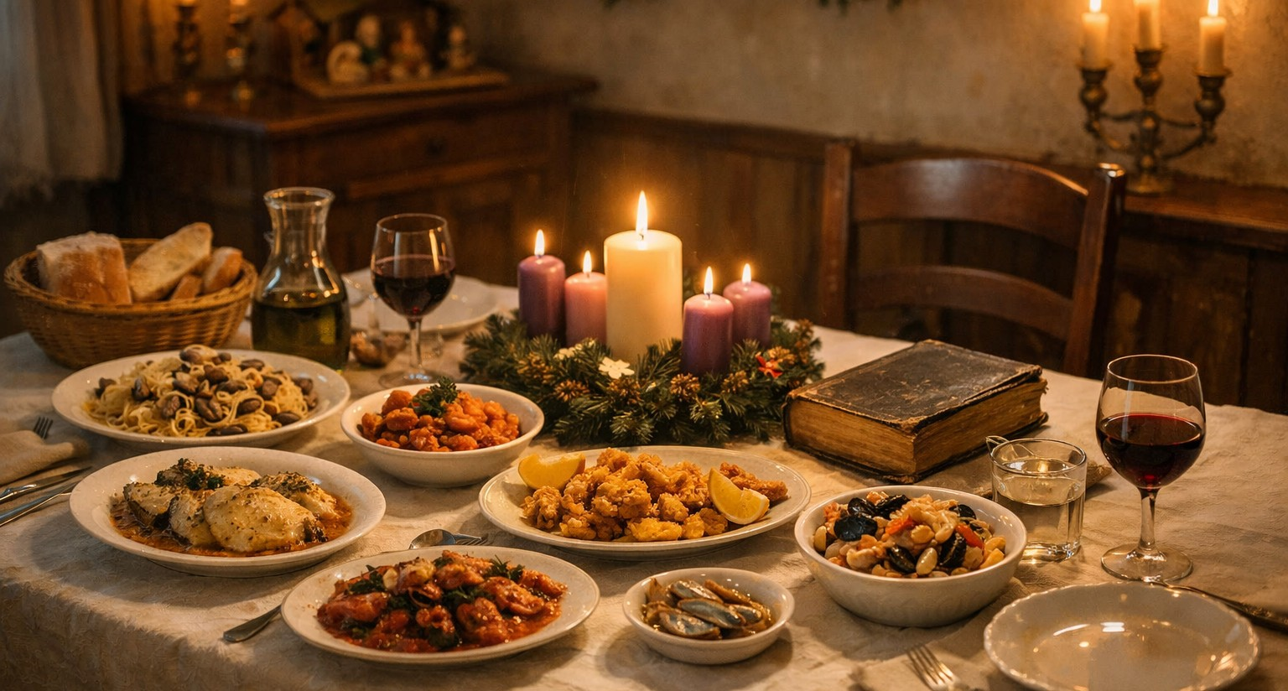
FOOD
In Christianity, food isn’t just for filling your stomach—it’s full of meaning! Communion bread and wine remind believers of Jesus’ sacrifice, turning a simple meal into a powerful act of faith. Feasts during Christmas, Easter, and other celebrations bring families and communities together, full of joy, gratitude, and sharing. Special foods make holy days festive, create lasting memories, and show how faith can be celebrated with love… and a little deliciousness!

Slide 9
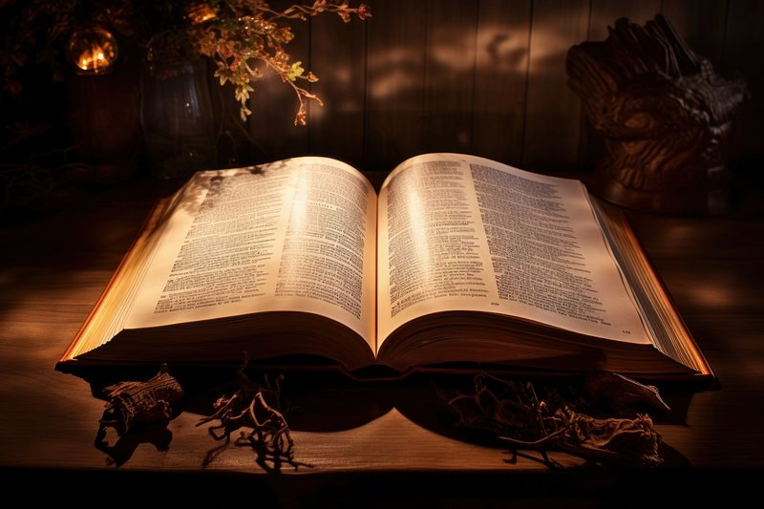
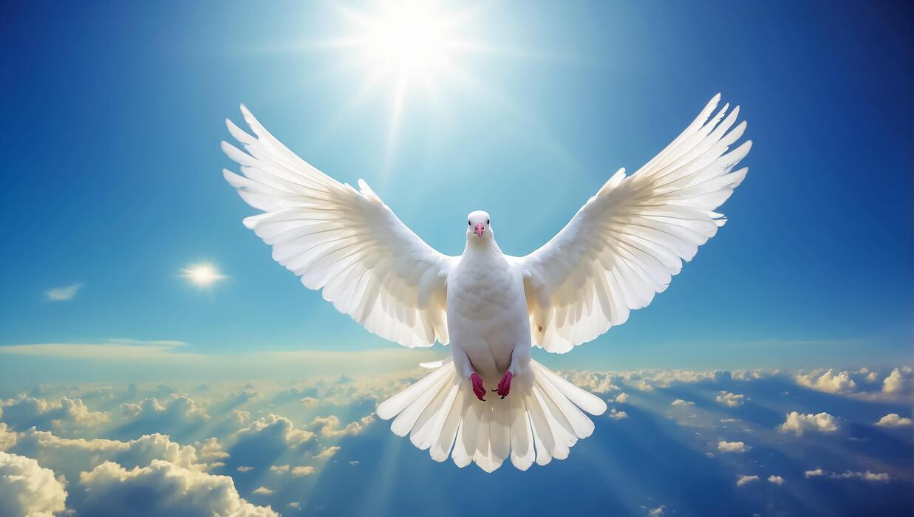
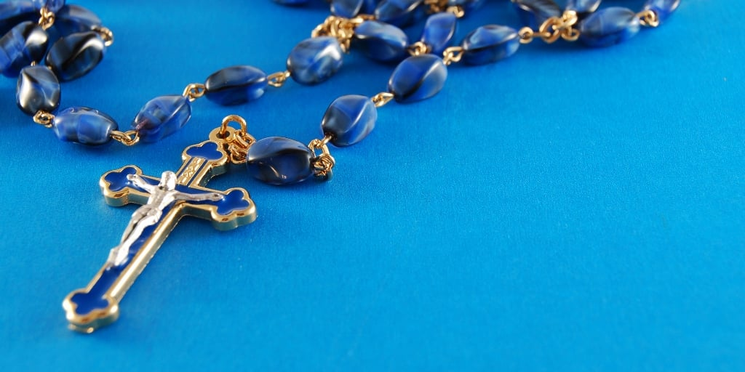
SYMBOLS
Christian symbols are more than just images—they carry deep meaning and teach important lessons. The cross represents Jesus’ sacrifice and the hope of eternal life. The dove symbolizes peace and the presence of the Holy Spirit. The Bible shows God’s word and guides believers in daily life, while the rosary helps focus prayer and meditation. These symbols make faith visible, inspire devotion, and help Christians connect with their beliefs in meaningful ways.

Slide 10
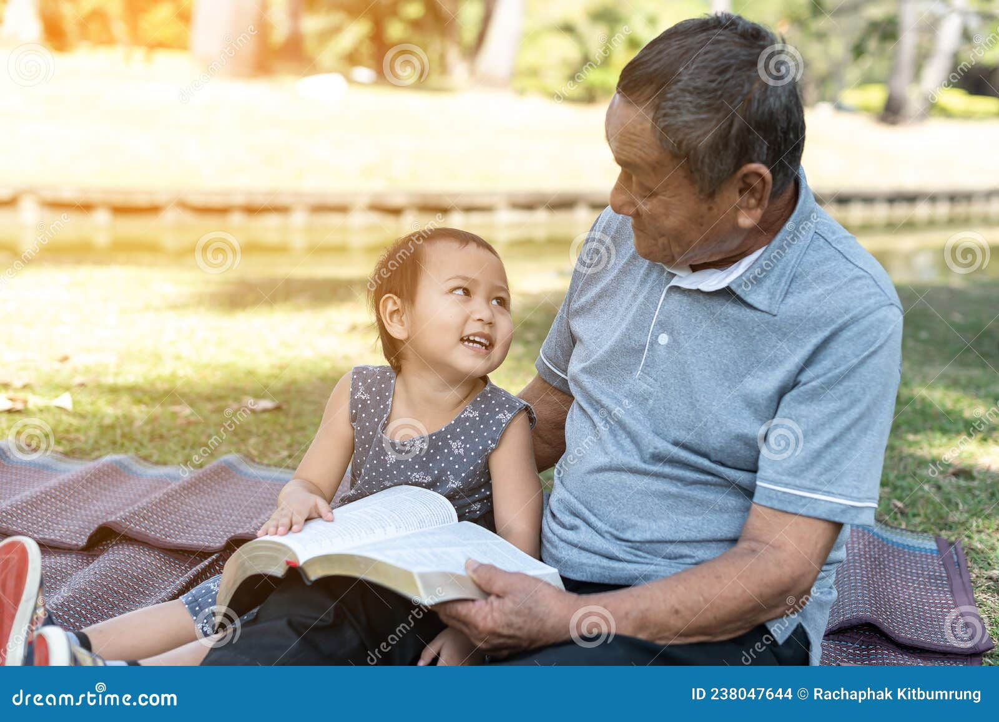
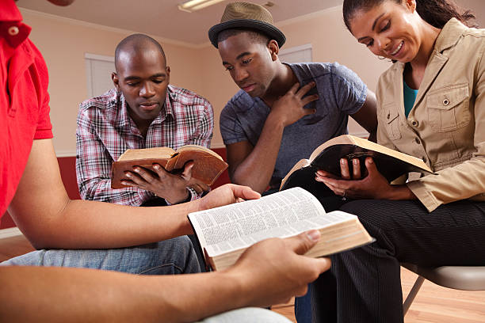
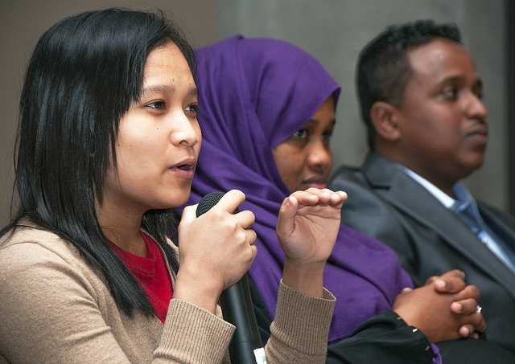
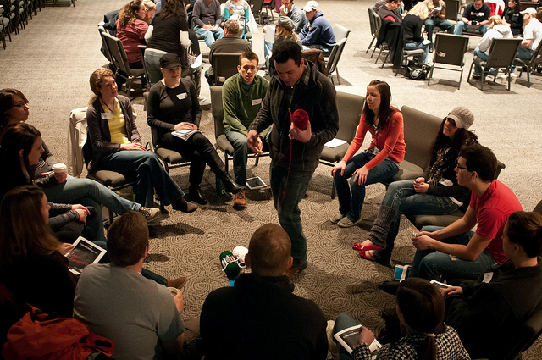
THE OUTREACH
Christianity has grown into a global faith, spreading across continents despite challenges like persecution, cultural differences, and historical conflicts. From its roots in the Middle East, it has adapted to countless cultures, languages, and traditions, creating a rich diversity of churches and practices around the world. Preaching the Gospel has been at the heart of this growth, as believers have shared the message of Jesus’ love, hope, and salvation even in difficult circumstances. Today, Christianity’s diversity and resilience show how faith can unite people across cultures while honoring their unique traditions.
This Photo by Unknown Author is licensed under CC BY-SA
This Photo by Unknown Author is licensed under CC BY

Slide 11
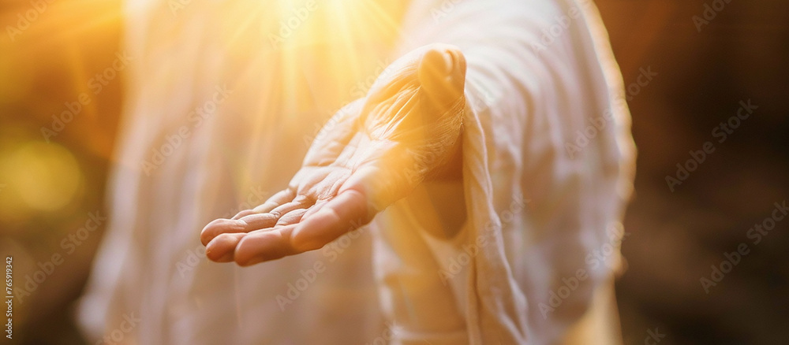
HAVE YOU COME TO REALIZE THAT YOU SHOULD TAKE HIS HAND?

