Slide 1



JUDAISM
AND…ALL ABOUT IT

Slide 2
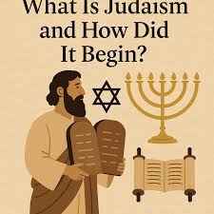
WHAT IS JUDAISM?
Judaism is one of the earliest monotheistic religions, dating back to about 2000 BCE in the ancient region of Canaan in the Middle East. Its origin is strongly connected to Abraham, who is recognized as the first individual to believe in a single God at a time when many societies practiced Polytheism. He established a covenant with God, in which God promised protection and land to him and his descendants, while they committed to worshipping only one God. This agreement laid the foundation of Judaism and introduced the concept of a unique relationship between God and the Jewish people.

Slide 3
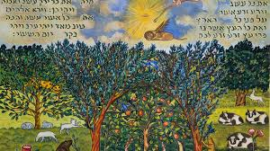
CREATION STORY
The Judaist creation story is found in the Book of Genesis in the Hebrew Bible. It teaches that God created the world in six days and rested on the seventh day, which became the Sabbath, a holy day of rest.
In the beginning, the earth was empty, dark, and formless. On the first day, God created light and separated it from darkness, calling them day and night. On the second day, He created the sky to separate the waters above from the waters below. On the third day, God gathered the waters to reveal dry land and also created plants, trees, and vegetation.
On the fourth day, He created the sun, moon, and stars to give light and to mark time, seasons, and years. On the fifth day, God created sea creatures and birds, blessing them to multiply. On the sixth day, He created land animals and then humans. Humans were made in God’s image and given responsibility to rule over and care for the earth.
On the seventh day, God rested, completing creation and setting a pattern of rest for humans to follow.

Slide 4
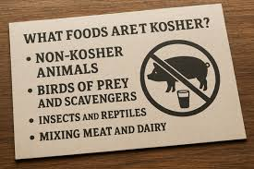
TEACHINGS ON LOVE, KINDNESS AND PEACE
In Judaist teachings, especially in the Hebrew Bible, love, justice, kindness, and peace are central values that guide how people should live and treat others.
Love is shown through devotion to God and care for others. People are taught to “love your neighbour as yourself,” meaning they should treat others with the same respect and concern they want for themselves.
Justice is about fairness and doing what is right. Leaders and individuals are expected to be honest, protect the weak, and make fair decisions without bias or corruption.
Kindness (often called mercy or compassion) encourages helping the poor, caring for strangers, and showing generosity to those in need. It teaches that goodness should be expressed through actions, not just words.
Peace is highly valued and is seen as a blessing. People are encouraged to avoid conflict, live harmoniously with others, and actively work towards reconciliation instead of hatred.

Slide 5
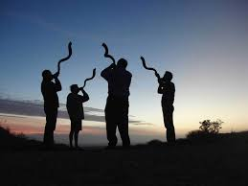
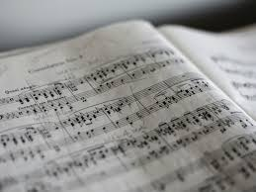
ROLES OF MUSIC
In Judaism, music plays a big spiritual and cultural role, especially in worship and religious life.
It is used to praise and worship God, especially through the Book of Psalms, which are often sung or chanted during prayers. For example, many Jewish services include psalms sung in Hebrew as part of daily or Sabbath worship.
Music also helps mark religious festivals and holy days. During Passover (Pesach), families sing traditional songs like Dayenu to remember the Exodus story. On the Sabbath (Shabbat), hymns called zemirot are sung at meals to create a peaceful, holy atmosphere.
In addition, music is used to express emotion and reflection. For example, during mourning periods like Shiva, slow, reflective melodies are sometimes used to express grief and remembrance.
Overall, music in Judaism connects people to God, strengthens community identity, and brings meaning to both joyful and solemn moments.

Slide 6
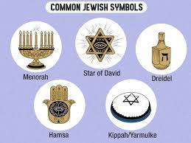
SACRED ITEMS
In Judaism, sacred items are physical objects used in worship and daily religious life to show respect for God and to remind believers of their faith and traditions.
One important item is the Torah scroll, which contains the first five books of the Hebrew Bible. It is the most sacred object in Judaism and is read in synagogues during services. It represents God’s teachings and guidance.
Another key item is the menorah, a seven-branched lampstand that symbolizes light, wisdom, and God’s presence. A special version called the Hanukkah menorah (hanukkiah) is used during the festival of Hanukkah to remember the miracle of the oil.
The mezuzah is a small case fixed on doorposts that contains a written prayer from the Torah. It reminds Jewish people of God’s commandments every time they enter or leave a home.
The yarmulke (kippah) is a skullcap worn by Jewish men (and sometimes women) to show respect and reverence for God.
The shofar, a ram’s horn, is blown during important holy days like Rosh Hashanah to call people to reflection, repentance, and spiritual renewal

Slide 7
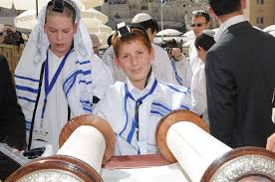
FESTIVALS IN JUDAISM
In Judaism, festivals are special religious celebrations that help people remember God’s actions, strengthen faith, and bring the community together.
One major festival is Passover (Pesach), which celebrates the Israelites’ freedom from slavery in Egypt. Families eat special foods like unleavened bread (matzah) and retell the story of the Exodus during a meal called the Seder.
Another important festival is Rosh Hashanah, which marks the Jewish New Year. It is a time of reflection, prayer, and asking for forgiveness. The shofar (ram’s horn) is blown to call people to repentance.
Closely linked to it is Yom Kippur, the holiest day in Judaism. It is a day of fasting, prayer, and seeking forgiveness from God and others.
There is also Hanukkah, which celebrates the miracle of the oil that lasted eight days in the Temple. Families light the menorah for eight nights, sing songs, and exchange gifts.
Another festival is Sukkot, which remembers the time Israelites lived in temporary shelters in the desert. People build small huts (sukkahs) and spend time eating and sometimes sleeping in them.

Slide 8
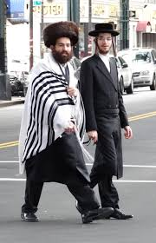
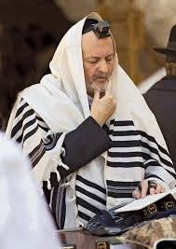
COSTUMES AND ATTIRE
In Judaism, traditional clothing is worn to show respect for God, identity, and religious commitment, especially during prayer and important events.
A key item is the kippah (yarmulke), a small cap worn on the head. It reminds Jewish people that God is always above them and that they should live with humility and respect.
Another important garment is the tallit, a prayer shawl worn during morning prayers. It has fringes called tzitzit, which remind the wearer to follow God’s commandments.
Some Jewish men also wear tefillin, small leather boxes strapped to the arm and head during weekday prayers. They contain verses from the Torah and symbolize devotion of both mind and action to God.
In more traditional communities, especially Orthodox Judaism, modest clothing is important. Men often wear dark suits, while women dress modestly with covered shoulders and skirts.

Slide 9
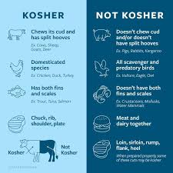
FOODS IN JUDAISM
Foods are split into two sections primarily known as Kosher and Non-kosher foods.
Kosher foods are those that are considered clean and allowed to eat according to Jewish law. These include animals that both chew the cud and have split hooves, like cows and sheep, as well as fish that have fins and scales, such as salmon and tuna. Fruits, vegetables, grains, and eggs are also kosher. For meat to be truly kosher, it must be slaughtered in a specific humane way and prepared properly.
Non-kosher foods are foods that are not allowed under these laws. This includes pork (pig), shellfish like shrimp and crab, and any meat from animals that do not meet the required conditions. It also includes mixing meat and dairy in the same meal, as this is forbidden in kosher practice.

Slide 10
Examples of kosher foods are known as:
Kosher foods include:
Animals that chew the cud and have split hooves, like cows and sheep
Fish that have fins and scales, like salmon and tuna
Fruits, vegetables, grains, nuts, and legumes
Eggs from kosher birds (like chicken)
Foods not allowed (non-kosher):
Pork (pig) and shellfish like shrimp and crab
Mixing meat and dairy in the same meal (no cheeseburger combo )
Animals not properly slaughtered according to Jewish law
Blood in meat must be fully removed

Slide 11
SYMBOLIC ITEMS IN JUDAISM
In Judaism, symbolic items are objects that represent deeper religious meanings, helping people remember God, their history, and their responsibilities.
One major symbol is the Star of David, a six-pointed star that represents Jewish identity and unity.
The menorah is also a key symbol. It represents light, wisdom, and God’s presence. It is especially used during Hanukkah to remember the miracle of the oil.
The shofar is a powerful symbol of repentance and spiritual awakening. It is blown during important holy days like Rosh Hashanah.
The tallit has fringes called tzitzit, which symbolize obedience to God’s commandments and living a holy life.
The mezuzah symbolizes God’s protection and constant presence in the home.

