Slide 1

ISLAM
It’s not just a religion, it’s a lifestyle…

Slide 2
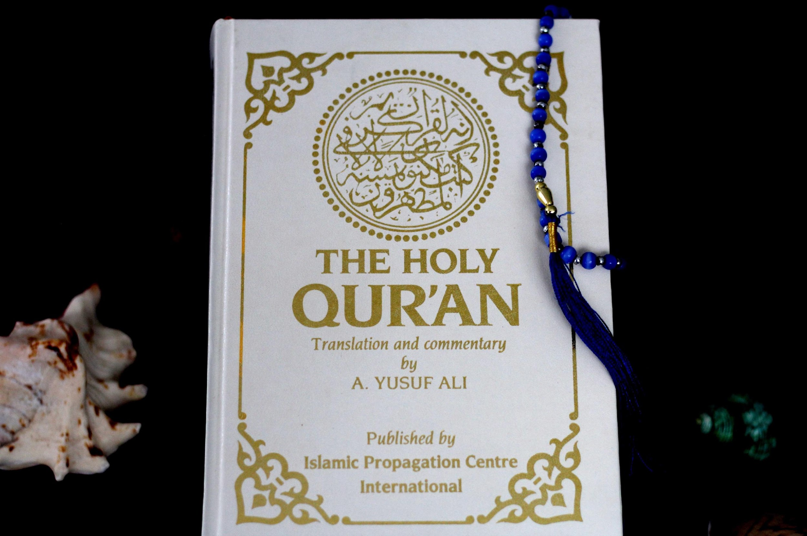

Slide 3
ORIGIN OF ISLAM 🕋
Islam began in the 7th century A.D. in the city of Mecca. It was founded by Prophet Muhammad, who received messages from Allah through Angel Jibril while praying alone in a cave. These messages were later written in the holy book known as the Qur'an. Islam was revealed to guide people to worship one God and live a good and peaceful life. (Yes o 😄, the religion really started in a cave!)

Slide 4
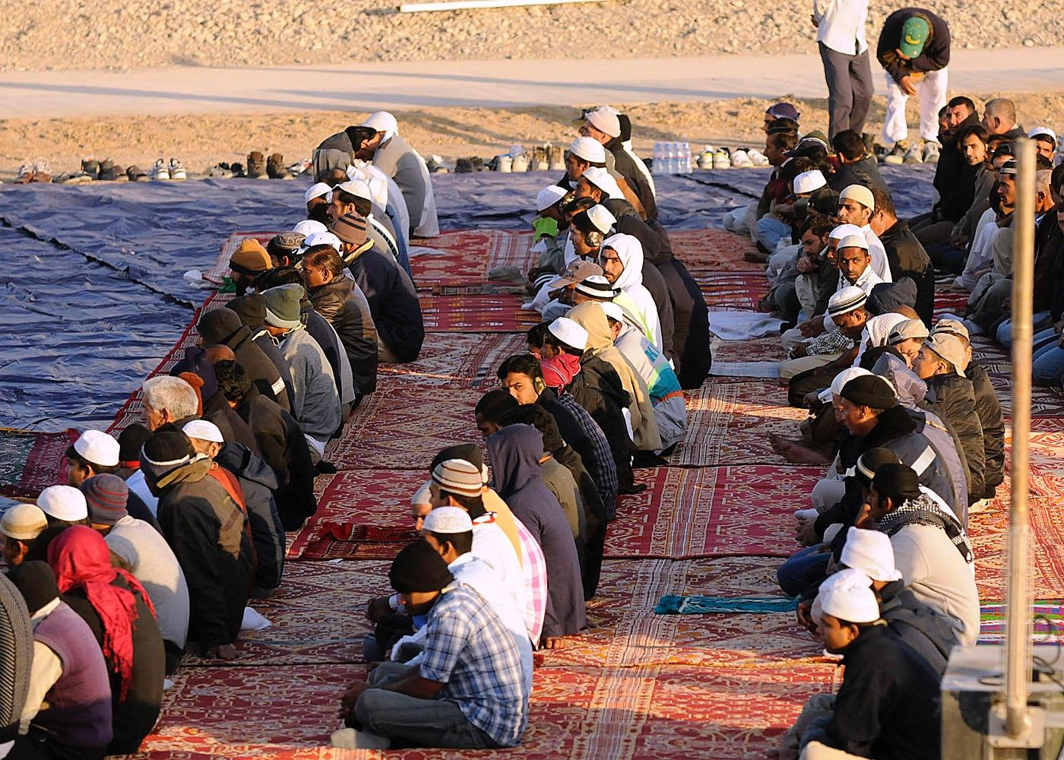
PRACTICES AND CULTURAL EXPRESSIONS 🙏
Muslims practice Islam through daily prayers, fasting during the month of Ramadan, giving charity to the poor, and going on pilgrimage to Mecca if they are able. These practices help Muslims stay disciplined, caring, and close to Allah. Cleanliness, greeting others with peace, and regular prayer are important parts of Muslim daily life. (Five prayers a day — alarm clocks are working overtime ⏰😅)

Slide 5
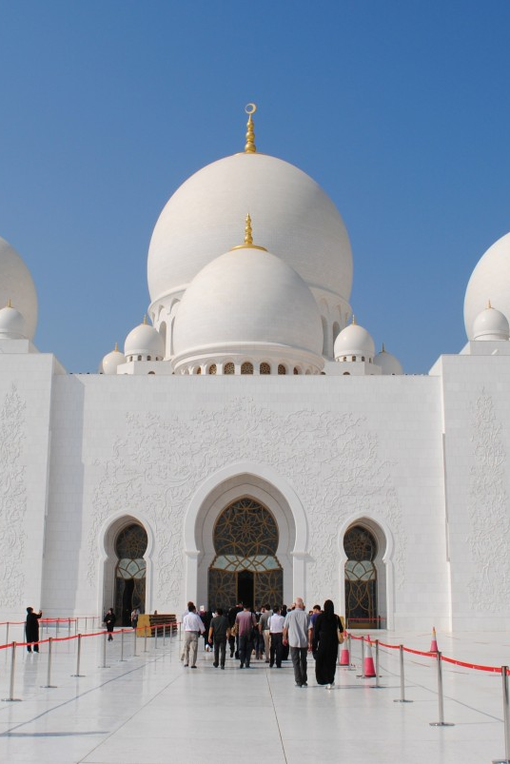
ISLAMIC CULTURE 🏠
Islamic culture encourages good behavior and respect for others. Muslims are taught to obey and respect their parents, take care of family members, and treat guests kindly. Modesty in dressing and behavior is important, and honesty is highly valued. In short, Islamic culture teaches people to be responsible, respectful, and well-behaved anywhere they go.

Slide 6
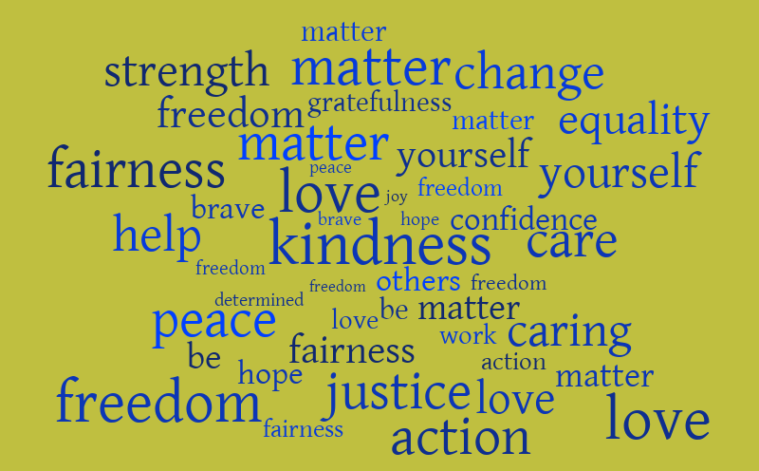
LOVE, KINDNESS, PEACE, AND JUSTICE ❤️🕊️⚖️
Islam strongly teaches love, kindness, peace, and justice. Muslims are encouraged to love one another, help the needy, and forgive people. Peace is a major message of Islam, and injustice is discouraged. The religion promotes fairness, compassion, and living peacefully with everyone. Simply put, Islam teaches people to choose kindness over violence.

Slide 7
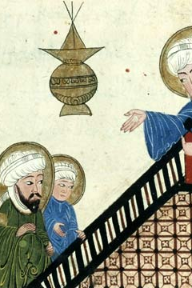
CREATION STORY 🌍
According to Islam, Allah created the universe and everything inside it. The first human beings were Adam and Hawwa (Eve). Humans were created to worship Allah and take care of the earth. This means people have a responsibility to live rightly and protect the world. (So no destroying the planet please 😄🌱)

Slide 8
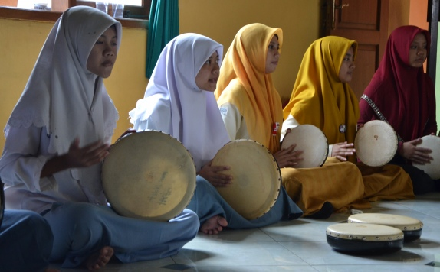
ROLE OF MUSIC IN WORSHIP 🎶
In Islam, music is used in a careful and respectful way. Musical instruments are not used during prayers, but the Qur’an is recited in a beautiful and rhythmic voice. The call to prayer, called the Adhan, is also chanted melodiously. Religious songs and poetry known as nasheeds are allowed and help teach good morals. (Not a party 🎉, but still very musical!)

Slide 9
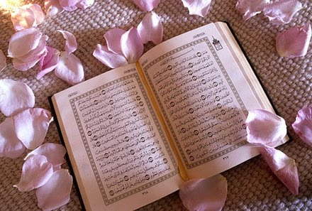
SACRED ITEMS USED IN RELIGIOUS PRACTICES 📿
Muslims use sacred items such as the Qur’an, prayer mats, and prayer beads called tasbih during worship. Mosques are special places for prayer and learning, while the Kaaba in Mecca is the holiest site in Islam. These items are treated with great respect because they are connected to Allah and worship.

Slide 10
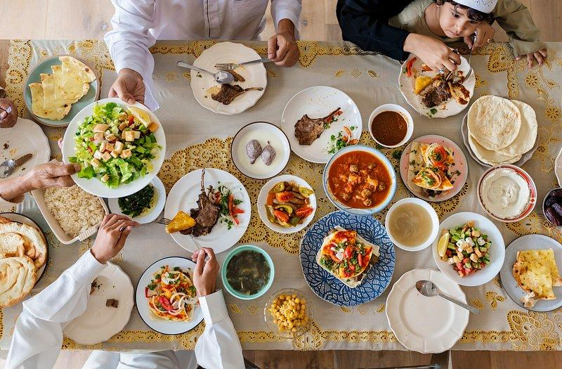
FEASTS AND FESTIVALS 🎊
Islam celebrates important festivals like Eid al-Fitr and Eid al-Adha. Eid al-Fitr marks the end of Ramadan, while Eid al-Adha celebrates sacrifice and obedience to Allah. During these festivals, Muslims pray together, wear new clothes, share food, and give to the poor. These celebrations help strengthen family and community bonds. (😋🍛)

Slide 11
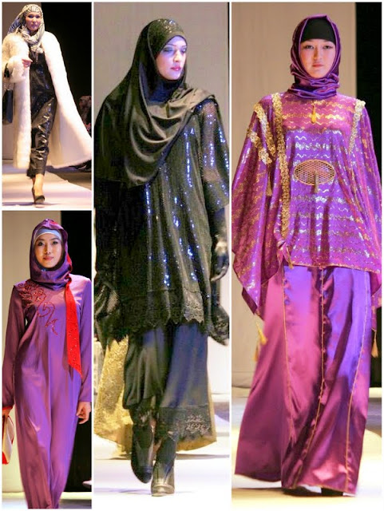
COSTUMES, FOOD, AND SYMBOLIC ITEMS 👗🍽️
Muslims dress modestly, wearing clothes such as hijabs, kaftansa, Jlabiyas, and prayer caps. They eat halal food, meaning food prepared according to Islamic rules, and they avoid pork and alcohol. Symbolic items like the crescent moon and prayer cap are commonly linked with Islam and represent faith and identity.

Slide 12
THANK YOU ALL!!!
Peace Aribasoye and Olatoye Fayobomi

