Slide 1


“ॐ शान्तिः शान्तिः शान्तिः।”?
(Om, peace, peace, peace.)
“विद्या ददाति विनयम्।”?
(Knowledge gives humility.)
“कर्मण्येवाधिकारस्ते मा फलेषु कदाचन।”?
(You have the right to perform your duty, but not to the fruits of your actions.) — Bhagavad Gita
“श्रद्धावान् लभते ज्ञानम्।”?
(The faithful attain knowledge.)
HINDUISM
“योगः कर्मसु कौशलम्।”?
(Excellence in action is yoga.)
“ॐ असतो मा सद्गमय।”?
(Lead me from falsehood to truth.)
“तमसो मा ज्योतिर्गमय।”
(Lead me from darkness to light.)
“मन एव मनुष्याणां कारणं बन्धमोक्षयोः।”?
(The mind is the cause of bondage and liberation.)

Slide 2
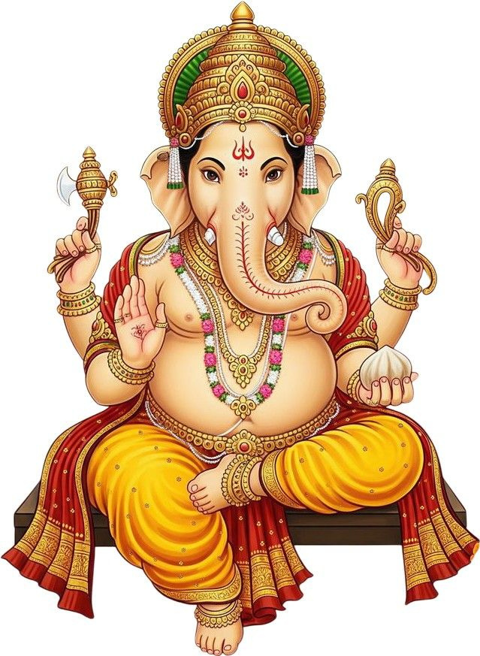
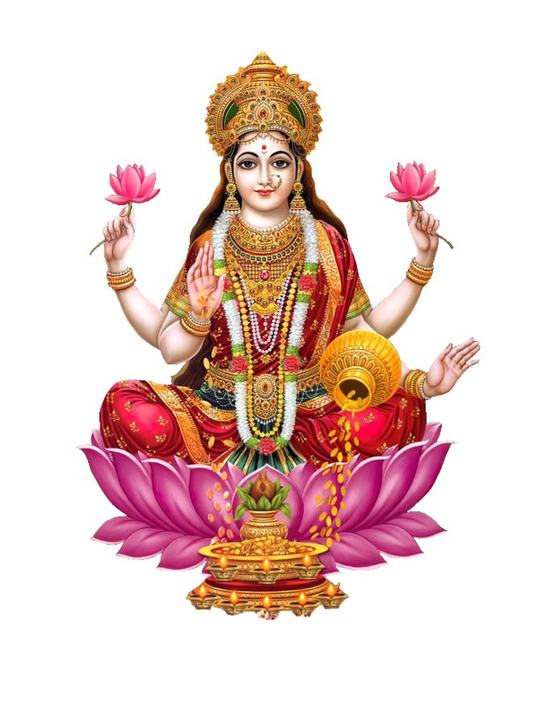
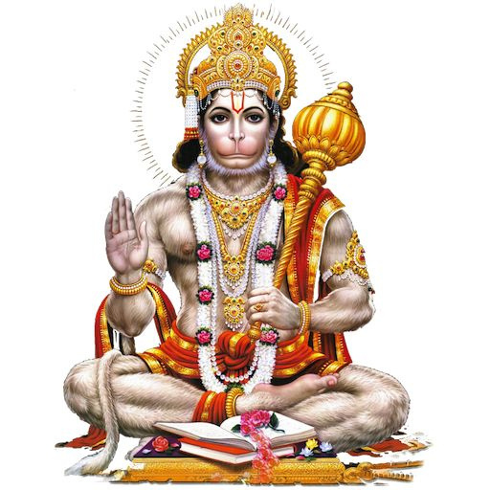
Faith Across Borders
ORIGIN OF HINDUISM
  Hinduism is one of the oldest religions in the world and began over 4,000 years ago in the Indus Valley region. It has no single founder but developed gradually over time. The earliest stage was the Vedic Period, when the Vedas were written and people worshipped nature gods through rituals. Later, the Upanishadic Period introduced deeper ideas like Brahman (ultimate reality) and Atman (soul). Over time, Hinduism grew through stories, beliefs, and devotion to major gods like Vishnu, Shiva, and Devi.
  About 1.2 to 1.3 billion people practice Hinduism worldwide. Some live in India and Nepal but are mostly in South Asia.

Slide 3
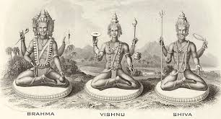
Faith Across Borders
CREATION STORY
  The most common theory of creation in the Hindu religion is not any one theory, but rather that of creation via the Trimurti (Hindu Trinity), as well as cycles of creation and destruction
  Hinduism describes creation as a function of the Trimurti, which includes three chief deities: Brahma, Vishnu, and Shiva. Brahma is responsible for creation, Vishnu for maintenance, and Shiva for destruction, after which another creation cycle begins.
  This type of creation is referred to as cyclic creation since there comes no permanent end to the universe. The universe simply goes through a series of cycles of creation, maintenance, destruction, and recreation.

Slide 4
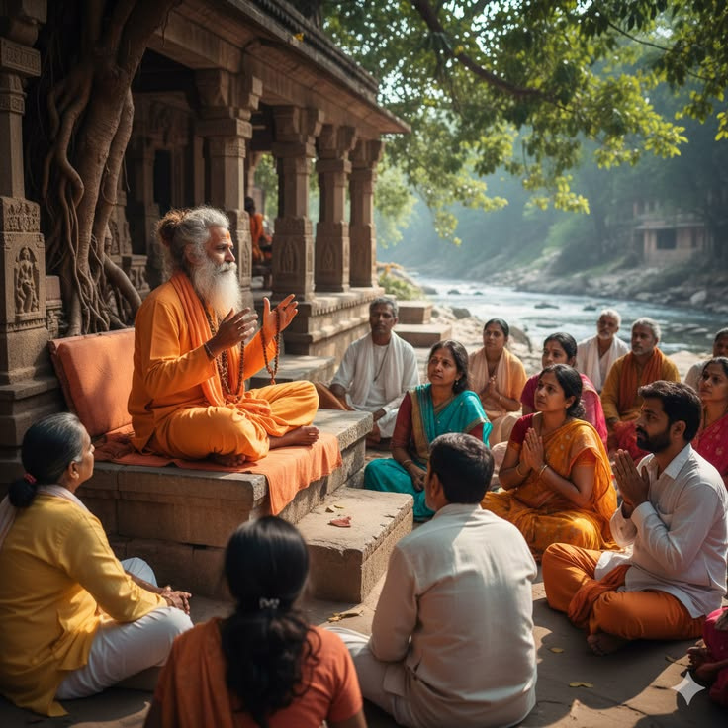
Faith Across Borders
BELIEFS
  Hinduism promotes the idea that there exists a supreme reality called Brahman that pervades everything in this universe. Similarly, it promotes the idea of Atman that constitutes the individual soul in each individual.
  The main objective in Hinduism is to attain a state called moksha, which involves freedom from the samsara process and achieving oneness with Brahman. Another important element in Hinduism is dharma.
  Hinduism claims to be monotheistic because of its belief in the central god called Brahman, but can also be seen as polytheistic because of the existence of smaller gods that some critics still believe are reflections of Brahman, the central god.

Slide 5
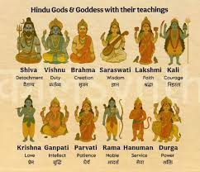
Faith Across Borders
DEITIES
  Brahma — Creator of the universe
  Vishnu — Preserver and protector
  Shiva — Destroyer and transformer
  Lakshmi — Goddess of wealth and prosperity
  Saraswati — Goddess of knowledge and wisdom
  Durga — Goddess of power and protection
  Kali — Fierce form of the goddess, destroyer of evil
  Hanuman — Monkey god, symbol of strength and devotion
  Ganesha — Elephant-headed god, remover of obstacles

Slide 6
Faith Across Borders
LOVE, KINDNESS, PEACE AND JUSTICE
  IN HINDUISM, LOVE, KINDNESS, PEACE, AND JUSTICE ARE IMPORTANT VALUES THAT GUIDE HOW PEOPLE SHOULD LIVE AND TREAT OTHERS.
  LOVE (PREMA / BHAKTI): HINDUS ARE TAUGHT TO LOVE ALL LIVING BEINGS BECAUSE THE DIVINE IS PRESENT IN EVERYONE. LOVING DEVOTION TO GOD AND COMPASSION FOR OTHERS ARE HIGHLY VALUED.
  KINDNESS (AHIMSA): A MAJOR TEACHING IN HINDUISM IS AHIMSA, WHICH MEANS NON-VIOLENCE AND KINDNESS TO ALL LIVING THINGS. THIS INCLUDES AVOIDING HARM TO HUMANS AND ANIMALS.
  PEACE (SHANTI): HINDUS BELIEVE PEACE COMES FROM SELF-CONTROL, MEDITATION, AND LIVING A RIGHTEOUS LIFE (DHARMA). INNER PEACE IS IMPORTANT FOR SPIRITUAL GROWTH.
  JUSTICE (DHARMA): JUSTICE IS LINKED TO DHARMA, WHICH MEANS DOING WHAT IS RIGHT AND FAIR. PEOPLE ARE EXPECTED TO ACT HONESTLY, FULFILL DUTIES, AND TREAT OTHERS FAIRLY.

Slide 7
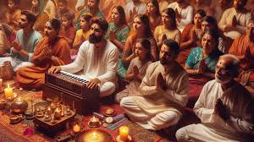
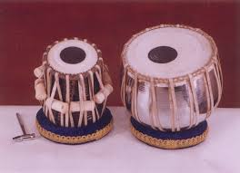
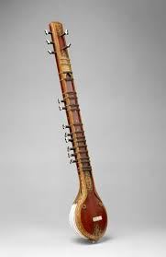
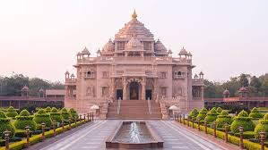
Faith Across Borders
ROLES OF MUSIC IN WORSHIP
  Music plays an important role in Hindu worship because it is believed to help people connect with God and express devotion.
  Hindus use bhajans (devotional songs) and kirtans (group chanting) to praise the gods. These songs are often sung in temples, homes, and during festivals. Chanting sacred sounds like “Om” is also common and is believed to represent the sound of the universe.
  Musical instruments such as the tabla, sitar, and drums are used during worship to create a spiritual atmosphere. Music is seen as a way to calm the mind, show love for God, and bring people closer to spiritual truth.
  Overall, music in Hindu worship is a form of devotion (bhakti) that helps believers focus on God and strengthen their faith.

Slide 8
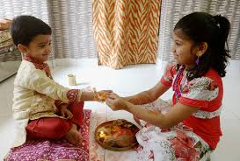
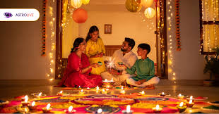
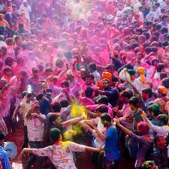
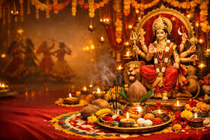
Faith Across Borders
FEASTS AND FESTIVALS
  Hindu festivals are special religious celebrations that honour gods, mark important events, and bring families and communities together.
  Diwali (Festival of Lights): Celebrates the victory of good over evil and light over darkness. Lamps and fireworks are used.
  Holi (Festival of Colours): A joyful spring festival where people throw coloured powders and celebrate love and happiness.
  Navaratri / Durga Puja: Celebrates the goddess Durga and the victory of good over evil.
  Raksha Bandhan: Celebrates the bond between brothers and sisters.
  Janmashtami: Celebrates the birth of Lord Krishna.
  Ganesh Chaturthi: Celebrates Lord Ganesha, remover of obstacles.

Slide 9
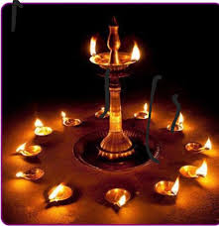

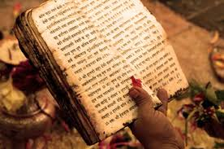
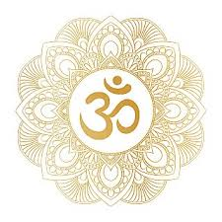
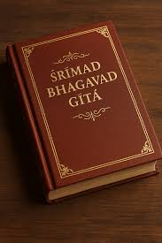
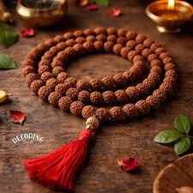
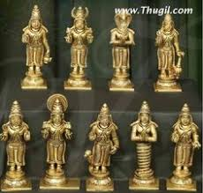
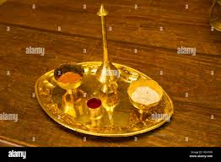
Faith Across Borders
SACRED ITEMS
  Idols (Murtis): Statues of gods used for worship in temples and homes
  Om (ॐ): Sacred sound representing the universe and ultimate reality (Brahman)
  Vedas: Holy scriptures containing prayers and teachings
  Bhagavad Gita: Sacred text with teachings of Krishna
  Lotus flower: Symbol of purity and spiritual growth
  Rudraksha beads: Used for prayer and meditation (japa mala)
  Tilak (forehead mark): Sacred mark worn during worship
  Incense and lamps (diya): Used in rituals to show devotion and light

Slide 10
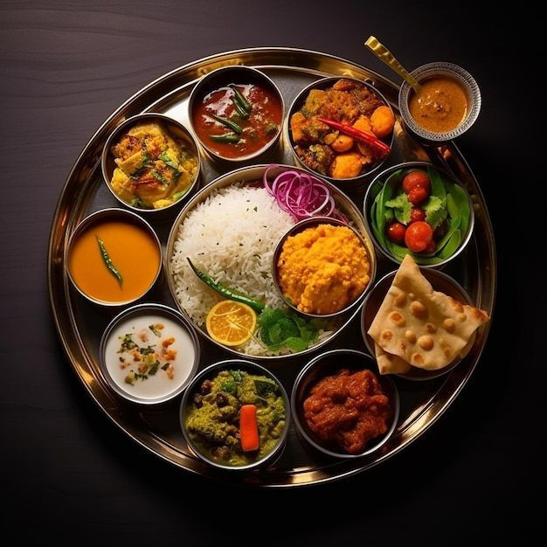
Faith Across Borders
FOODS
  Many Hindus are vegetarian because of ahimsa (non-violence)
  Beef is avoided because the cow is considered sacred
  Food offered to God is called prasadam and is eaten as holy food
  Meals are prepared with cleanliness and respect
  Some Hindus fast on special religious days

Slide 11



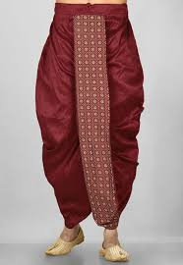


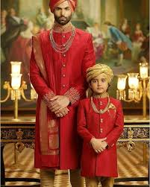
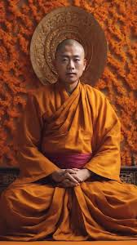
Faith Across Borders
CLOTHING
  Hindu clothing combines religion, culture, and social values, with traditional dress playing an important role in daily life, worship, and ceremonies.
  In Hinduism, clothing reflects modesty, purity, and respect for tradition. Common examples include:
  Sari – worn by women
  Salwar Kameez – women’s traditional outfit
  Lehenga Choli – festive women’s wear
  Dhoti – traditional men’s clothing
  Kurta Pajama – common men’s attire
  Sherwani – formal men’s wear
  Saffron Robes – worn by monks and spiritual leaders
  White Garments – used for purity or mourning

Slide 12
Faith Across Borders
Main Practices Carried Out in Hinduism
  Puja (Worship)
    Daily prayers and offerings to deities at home or in temples.
  Meditation and Yoga
    Spiritual exercises for mental, physical, and spiritual growth.
  Reading Sacred Texts
    Study of scriptures like the Bhagavad Gita, Vedas, and Upanishads.
  Festivals
    Celebrations such as Diwali, Holi, and Navratri.
  Fasting (Vrat)
    Observing fasts for purification and devotion.
  Pilgrimage (Tirtha Yatra)
    Visiting sacred places like Varanasi and the Ganges River.
  Rituals and Ceremonies (Samskaras)
    Religious rites for birth, marriage, and death.
  Charity (Dana)
    Giving to the poor and helping others.
  Respect for Cows and Nature
    Reverence for animals and the environment.
  Temple Visits
    Seeking blessings, making offerings, and participating in communal worship

Slide 13

Faith Across Borders
THANK YOU

