Slide 1

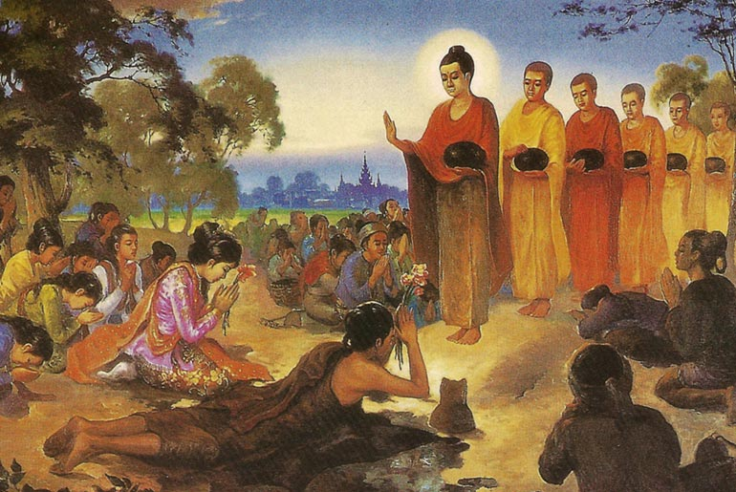

BUDDHISM
"Let go, find peace.“

Slide 2
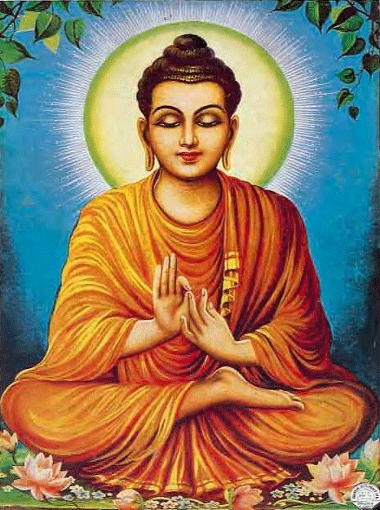

What is Buddhism ?
  Buddhism is a religion and way of life relating to a primordial god known as the Buddha, which teaches people how to overcome suffering and achieve inner peace. It focuses on understanding the nature of life, developing wisdom, and living morally through right thoughts and actions.
  Buddhism has approximately 500 million to 535 million followers worldwide, making it the world's fourth-largest religion (following Christianity, Islam, and Hinduism).
  It was formed by a prince whose curiosity led him to discover the pain of man and their suffering, and his name is Siddhartha Gautama
Siddhartha Gautama here is represented as Buddha, the supreme deity of the Buddhists

Slide 3
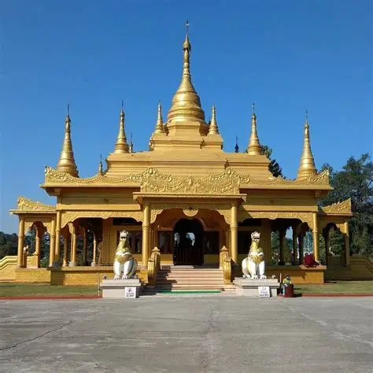
Cultural Practices of the Buddhist Lifestyle
  Cultural expressions of Buddhism are seen in the visible and artistic ways the religion is practiced and preserved in different societies. Temples and monasteries serve not only as places of worship but also as centres for teaching, meditation, and community gatherings. Their architecture often reflects Buddhist beliefs, with features such as stupas, pagodas, and prayer halls designed to symbolize enlightenment and spiritual growth. Statues and images of the Buddha, often shown in specific postures (mudras), communicate particular meanings such as peace, meditation, or teaching.
  Festivals like Vesak are widely celebrated with processions, chanting, acts of charity, and the lighting of lanterns, symbolizing the spreading of wisdom. Monks and nuns express Buddhist values through their simple robes, shaved heads, and disciplined lifestyle, representing detachment from worldly desires.
  Buddhist art, including paintings, carvings, mandalas, and sacred symbols like the lotus flower and the Wheel of Dharma, visually communicate core teachings about purity, the cycle of life, and the path to enlightenment. Through these cultural forms, Buddhist beliefs are not only practiced but also preserved and passed down from one generation to another.
The Golden Pagoda Namsai Arunachal Pradesh

Slide 4

The Role of Music in Buddhistic Worship
  Music plays a significant role in Buddhism as a support for meditation, ritual worship, and the expression of core teachings. Chanting sacred texts and mantras helps practitioners concentrate, calm the mind, and develop mindfulness, which are essential for spiritual growth.
  The repetition of chants strengthens memory of the teachings and encourages discipline. Musical instruments such as bells, gongs, drums, and cymbals are used during ceremonies to mark transitions in prayer and to create a solemn, reflective atmosphere. The sound of these instruments often symbolizes important Buddhist ideas, such as impermanence and spiritual awakening.
  Music is also used during major festivals and communal gatherings, helping to unite believers and deepen their sense of shared faith. In some traditions, such as Tibetan Buddhism, specific sounds are believed to promote healing and inner balance. Overall, music in Buddhism is not merely entertainment but a meaningful tool that reinforces teachings, strengthens community, and enhances spiritual practice.
The Mokugyo traditional Mahayana Buddhist percussion instrument

Slide 5

FESTIVALS IN BUDDHISM
  festivals in Buddhism reflect important teachings such as compassion, generosity, and self-discipline. Many Buddhists practice moderation in eating, and vegetarianism is common because it supports the principle of non-violence toward all living beings. Monks depend on alms (food offered by lay followers), which strengthens the relationship between the Sangha and the community. Meals are often simple, including rice, vegetables, fruits, and tea, emphasizing purity and detachment from luxury. Festivals play a major role in expressing Buddhist faith.
  Vesak (Buddha Day) is the most important festival, commemorating the birth, enlightenment, and death of the Buddha; it is marked by temple visits, chanting, meditation, lighting lanterns, and acts of charity.
  Magha Puja celebrates an important gathering of the Buddha and his disciples and focuses on teachings about unity and moral discipline.
  Asalha Puja (Dharma Day) marks the Buddha’s first sermon and the beginning of the Sangha, reminding followers of the importance of spreading the teachings. In many Asian countries, the Buddhist New Year is celebrated with prayers, cleaning of homes and temples, water rituals, and sharing food with family and the needy. These festivals reinforce key Buddhist values and strengthen both spiritual reflection and community bonds
The Magha Puja Festival

Slide 6
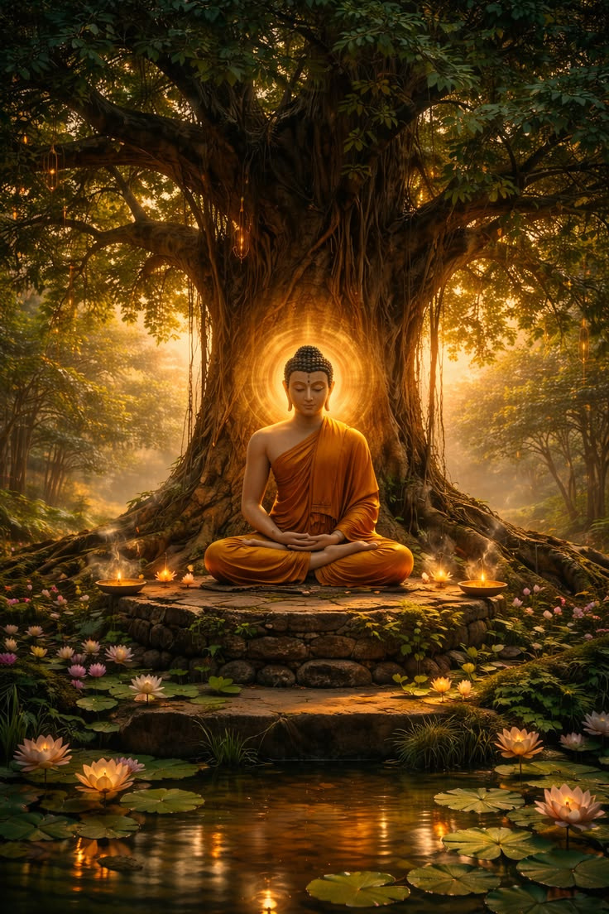
The Creation Story of Buddhism
  Unlike many religions, Buddhism does not teach a single creation story where a supreme God created the world. Instead, it explains the origin of the world through natural cycles of cause and effect. According to Buddhist teachings, the universe goes through endless cycles of formation, existence, destruction, and re-formation. There is no clear beginning or final end—existence is continuous and shaped by karma (actions and their consequences).
  One well-known explanation appears in Buddhist texts, where it is taught that after a world is destroyed, it gradually reforms. Beings are first reborn in a heavenly state, shining with light and living in happiness. Over time, as desire and greed develop, they begin to consume material food, lose their brightness, and become more physical and human-like. As selfishness increases, social problems, inequality, and suffering also arise. This story is not meant to be scientific but symbolic, teaching that human suffering begins with craving and attachment.
  In Buddhism, the focus is not on how the world was created but on how suffering begins and how it can be ended. The creation account therefore emphasizes moral lessons about karma, impermanence, and the consequences of human actions rather than a single divine act of creation.

Slide 7
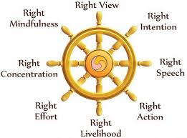
THE ENRICHING CULTURE OF BUDDHISM
  Buddhist culture refers to the way Buddhist beliefs are expressed in daily life, traditions, art, and social values across different countries. Although Buddhism began in India, it spread to places such as China, Japan, Thailand, Sri Lanka, and Tibet, and each region developed unique cultural practices while maintaining core teachings.
  A major part of Buddhist culture is respect for the Sangha (monastic community). Monks and nuns live disciplined lives devoted to meditation, study, and teaching. Lay followers support them by offering food and other necessities, which strengthens community bonds and encourages generosity. Respect for elders, humility, and peaceful behavior are also strong cultural values influenced by Buddhist teachings.
  Buddhist culture is clearly seen in temple architecture, statues of the Buddha, paintings, and symbols such as the lotus flower (purity) and the Wheel of Dharma (the teachings). Meditation practices, chanting, and the observance of moral precepts shape everyday behavior. Festivals like Vesak and other holy days bring communities together for prayer, charity, and reflection.
  In many societies influenced by Buddhism, cultural life emphasizes simplicity, self-control, compassion, and harmony with others. Overall, Buddhist culture reflects the religion’s focus on moral living, mindfulness, and the pursuit of inner peace.
The Wheel Of Dharma

Slide 8
LOVE, KINDNESS, PEACE AND JUSTICE
In Buddhism, love and kindness are central virtues that guide how individuals relate to others. Love is expressed through Metta, which means selfless loving-kindness toward all living beings without discrimination. It encourages wishing happiness and well-being for everyone, including strangers and even those who may cause harm. Closely connected to this is compassion, the desire to understand and reduce the suffering of others through patience, generosity, and forgiveness.
Peace in Buddhism begins within the individual. Through meditation, mindfulness, and moral discipline, a person learns to control anger, hatred, and greed—qualities that lead to conflict. When inner peace is developed, it naturally extends to families, communities, and society, promoting harmony and non-violence.
Justice in Buddhism is based on the principle of karma, which teaches that every action has consequences. Rather than focusing on punishment, Buddhist justice emphasizes personal responsibility and moral accountability. Good actions produce positive results, while harmful actions lead to suffering. Therefore, love, kindness, peace, and justice are interconnected values that encourage ethical living and the reduction of suffering in the world.

Slide 9

Sacred Items Used in Buddhist Religious Practices
  In Buddhism, several sacred items are used during worship, meditation, and religious ceremonies to support spiritual practice and express devotion. One important item is the statue or image of the Buddha, which serves as a symbol of enlightenment and reminds followers of his teachings. Buddhists bow before these images as a sign of respect, not worship of a god, but honor for the Buddha’s wisdom.
  Another sacred object is the prayer beads (mala), which are used to count recitations of mantras during meditation. A mala usually contains 108 beads, representing the number of human desires to be overcome. Incense is also commonly burned in temples and homes to symbolize purity and the presence of spiritual awareness.
  Bells, gongs, and drums are used in rituals to mark the beginning and end of prayers and to create a calm, reflective atmosphere. In Tibetan Buddhism, prayer wheels and singing bowls are used to accompany chanting and meditation. Additionally, sacred texts such as the Tripitaka (Three Baskets) are highly respected because they contain the teachings of the Buddha.
  These sacred items help Buddhists focus their minds, show reverence, and deepen their understanding of the path to enlightenment
The Tripitaka the foundational collection of sacred scriptures in Buddhism, particularly Theravada tradition.

Slide 10
COSTUMES, FOOD, AND SYMBOLIC ITEMS
  In Buddhism, costumes, food, and symbolic items reflect important spiritual values such as simplicity, discipline, and respect. Monks and nuns wear simple robes, usually in colors like saffron, orange, maroon, or yellow, depending on the country and tradition. These robes symbolize humility, detachment from worldly possessions, and commitment to spiritual life. Lay Buddhists typically dress modestly when visiting temples as a sign of respect.
  Food in Buddhism emphasizes moderation and non-violence. Many Buddhists practice vegetarianism to avoid harming living beings, reflecting the teaching of compassion. Monks often receive food as alms from the community and eat simple meals such as rice, vegetables, fruits, and tea. In some traditions, monks do not eat after midday as a form of self-discipline. During festivals, special meals are prepared and shared, often accompanied by acts of charity.
  Symbolic items are also important in Buddhist practice. The lotus flower represents purity and spiritual growth, as it rises clean from muddy water. The Wheel of Dharma symbolizes the teachings of the Buddha and the path to enlightenment. Prayer beads (mala), incense, and candles are used during meditation and worship to promote focus and mindfulness. Together, these costumes, foods, and symbolic items help express Buddhist beliefs and strengthen spiritual practice.

Slide 11
Thank
You

